Slide 1

Extralink
Cybersecurity Distributor
Notes:
Welcome to our company’s presentation, I am Daniel Estrada, President of Extralink Corporation

Slide 2
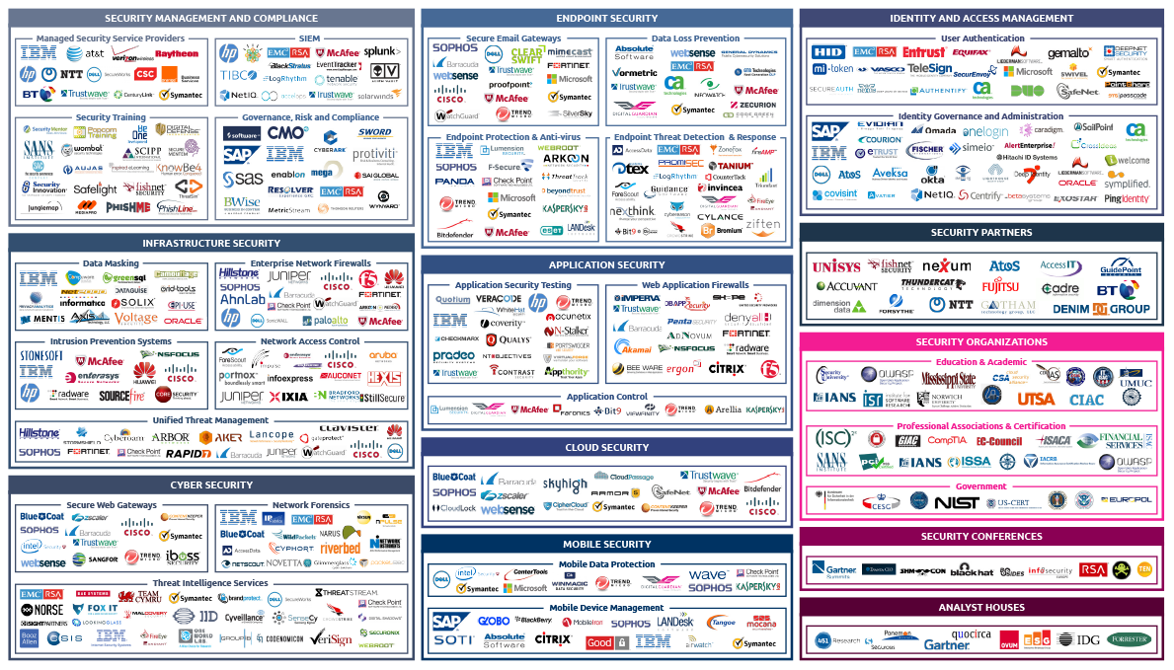
Landscape
Panorama industria Ciber Seguridad
Notes:
You have all types of Security here: Infrastructure, Cyber, Endpoint, Application, Cloud, Mobile, etc. Each solution is a siloed solution making the Chief Information Security Officer have dozens of screens and reports to try to find out if they are prone for a devasting attack. With such a complex landscape in our Information Security Industry, how can I get a single window view of where my customer is at security-wise? This is probably the biggest problem in our industry today.

Slide 3



3 niveles de requerimientos en Cyber Security
Pre-Attack
Attack
Post-Attack
Penetration Testing
Vulnerability Scanning
Attack Simulators
Antivirus
EDR
Firewall
IPS/IDS
Forensics Tools
Logs
Notes:
There are 3 main areas in the cyber security world, preventing getting attacked, countering an ongoing attack, and an attack’s post mortem. During an attack you have your antivirus, Endpoint Detection and Response, Firewalls and Intrusion detection and prevention systems. After the attack you have forensics tools to see what happened which is a very messy affair.
Cronus is in the prevention game and grabbed Penetration Testing and Vulnerability Scanning, eliminated all their shortcomings and developed an award winning solution.

Slide 4



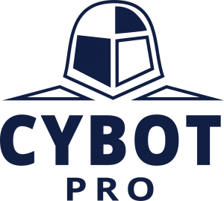
Productos: Orchestra Group
Ciberseguridad para los ambientes IoT
Tecnologia para priorizar las Vulnerabilidaes

Slide 5

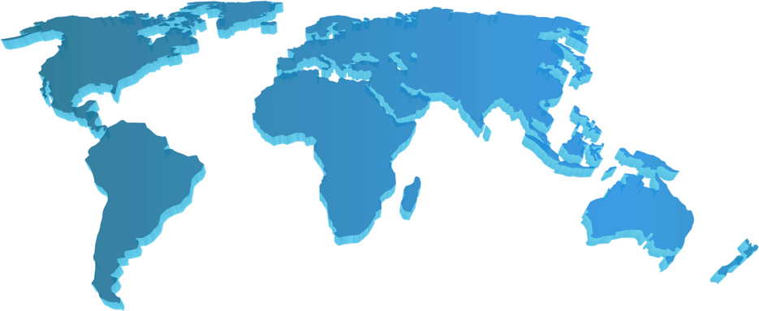


ORCHESTRA
Resumen
Datos Clave
Orchestra Group fundada en el 2018
Cy-oT (Harmony IoT) adquisicion de Orchestra Group en Ago 2018
Cronus Cybertechnologies adquirida en Abril 2020
Presencia global – 3 Oficinas | Tel Aviv, NYC, Belarus
40 Empleados, 26 en I&D
3 Principales lineas de producto
Socios de negocios en todo el mundo (incluyendo Latam)
Orchestra Locations
Israel
R&D
Sales
Management
Europe
R&D
USA
Product
Sales
Management
Industrias & Verticales
Financiero
Educacion
Gobierno
Seguridad
Seguros
Salud
Transporte

Slide 6
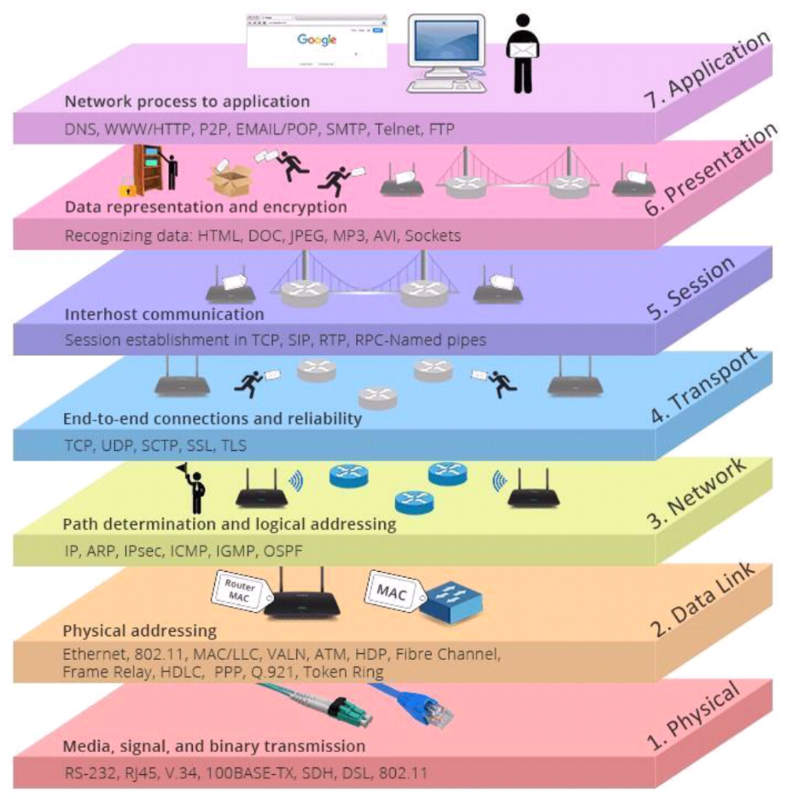
Ciberataques por capa OSI
Tipos de Ataques
Exploit
Phishing
Hijacking
Reconnaissance/DOS
Man in the Middle
Spoofing
Sniffing
Notes:
These are examples of types of attacks that are perpetrated against the different OSI layers and although there are many more, it illustrates how hackers try to find weaknesses anywhere, anytime, anyhow.

Slide 7
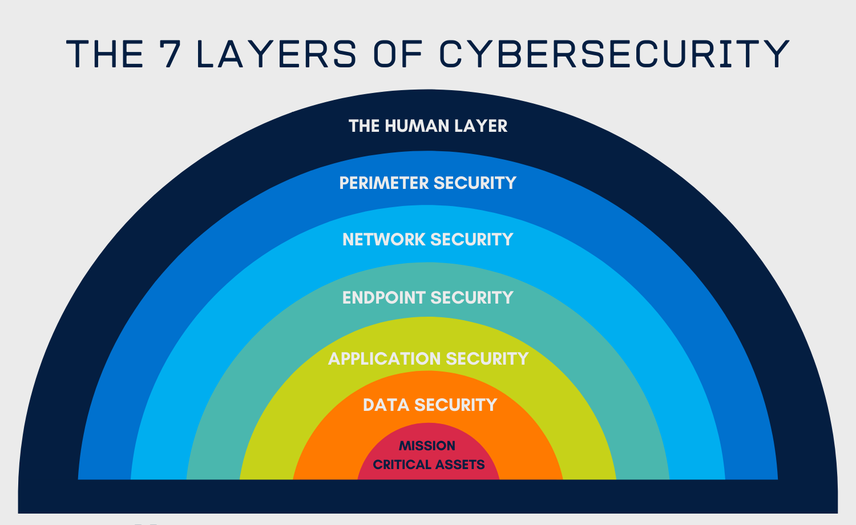
Las 7 Capas de Ciberseguridad
La Capa Humana
Training
Empathy, Consideration &
Compassion
Probing
Seguridad de Perímetro
Security should be easy
Repetition &
Reinforcement
Secure DMZs
Message Security
(Anti-Virus, Anti-Malware)
Business Data
Privacy
Seguridad de Red
Honeypot
Updated Home
Office Equipment
Perimeter IDS/IPS
Web Proxy
Content
Filtering
NAC
DLP
Consumer Data
Privacy
Enterprise
Message
Security
Inline Patching
Seguridad de Endpoint
Remote Working
Here to Stay
Perimeter
Firewall
Endpoint
Security
Enforcement
DHS Einstein
Content Security
(Anti-Virus,
Anti-Malware)
Enterprise
Wireless
Security
Host
IDS/IPS
Seguridad de Aplicaciones
FDCC
Compliance
Enterprise
IDS/IPS
WAF
Enterprise
Remote
Access
Dynamic
App Testing
Data Integrity Monitoring
Patch
Management
Desktop
Firewall
Seguridad de Datos
Database
Monitoring
Data
Wiping /
Cleansing
Identity & Access Mgmt
Enclave
Datacenter
Firewall
Static App
Testing Code
Review
Enterprise Right Mgmt
Data Classification
Database
Secure
Gateway
DLP
DLP
DAR/DIU/DIM
Protection
Activos
Críticos para Misión
Data Drive
Encryption
PKI
DLP
Security Policies & Compliance
Cyber Threat Intelligence
Risk Management
Vulnerability Assessment
Prevención
Operaciones
SIEM
Digital Forensics
SOC/NOC Monitoring (24x7)
Security Architecture & Design
Security Awareness Training
VPT
Security Dashboard
Continuous Monitoring and Assessment
IT Security Governance
Continuous C&A
Threat Modeling
Pen Test
Escalation Management
Incident Reporting, Detection, Response
Security SLA/SLD Reporting
Notes:
These are the 7 layers of Cybersecurity.
----
Continuous C&A: Certification and Accreditation
DLP: Data Loss Prevention
PKI: Public Key Infrastructure
NAC: Network Access Control
WAF: Web Application Firewall
DAR: Data At Rest
DIU: Data In Use
DIM: Data In Motion
DHS: Department of Homeland Security
IDS: Intrusion Detection System
IPS: Intrusion Prevention System
DMZ: Demilitarized Zone

Slide 8

DRAFT
El mundo en el que vivimos
67%
74%
9%
De los ataques no son prevenidos
De los ataques no son detectados
De las alertas de ataque son controladas por el SIEM

Slide 9
DRAFT
CyBot es una VPT (Vulnerability Prioritization Technology)
CyBot – la solucion que:
  Permite a las organizaciones priorizar sus riesgos ciberneticos basados en la criticidad de sus activos y analitica avanzada
  Facilita a las organizaciones invertir su tiempo y recursos en aquellas vulnerabilidades que amenazan sus activos criticos y los procesos de negocio
  Dispone de la tecnologia patentada de APS (Attack Patch Scenario™), el sistema crea una lista priorizada de vulnerabilidades haciendo Inteligencia Artificial
  Habilita a que las organizaciones reduzcan sustancialmente sus brechas de seguridad con la minima cantidad de tiempo y esfuerzos apoyandose en el uso eficiente de los recursos

Slide 10


DRAFT
Cybot Asegura la Efectividad en el Control de la Seguridad
CyBot – capacidades de automatizacion para Red Team
  Simula como un RT atacaria su ambiente
  Busca las vulnerabilidades y las usa para moverse en su ambiente y “captura la bandera” de sus activos criticos
  Usa los Escenarios de Ruta de Ataque o Attack Path Scenarios para crear una lista prioritizada de ataques ciberneticos a sus activos, aplicaciones y dispositivos
CyBot – capacidades de automatizacion para Blue Team
  Dezpliega los APS (Attack Path Scenarios) para recomendar controles efectivos
  Por ejemplo, Cybot puede recomendar un parcheo de un servidor de alto riesgo a uno mas bajo, compensando controles basado en las consderaciones del

Slide 11


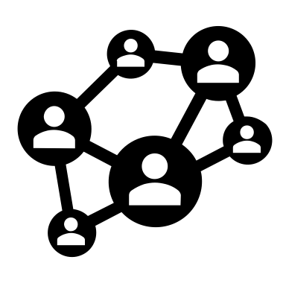

DRAFT
Automated Purple Teams - Asegure la efectividad en el control de la seguridad
Visibilidad
  Visibilidad continua de todos los dispositivos incluyendo end points, aplicaciones, servers
  Mapeo de la Red, validacion de la conectividad
Evalua y prioriza vulnerabilidades, procesos de negocio, riesgos
  Muestra la lista de aquellas Explotables que amenzan el proceso de negocio
  Analisis tipo OVAL (Open Vulnerability Assesment language)
Attack Path Scenarios ™
  Red Multi sitio
  Visualiza todos los ataques y focaliza en los mas sofisticados
  Continuamente valida los controles a los activos joya de la corona
Reportes, Remediacion y Automatizacion
  Procesos de Negocios clave y activos criticos
  Reportes completos
  Sugiere las Remediaciones y mitigaciones

Slide 12
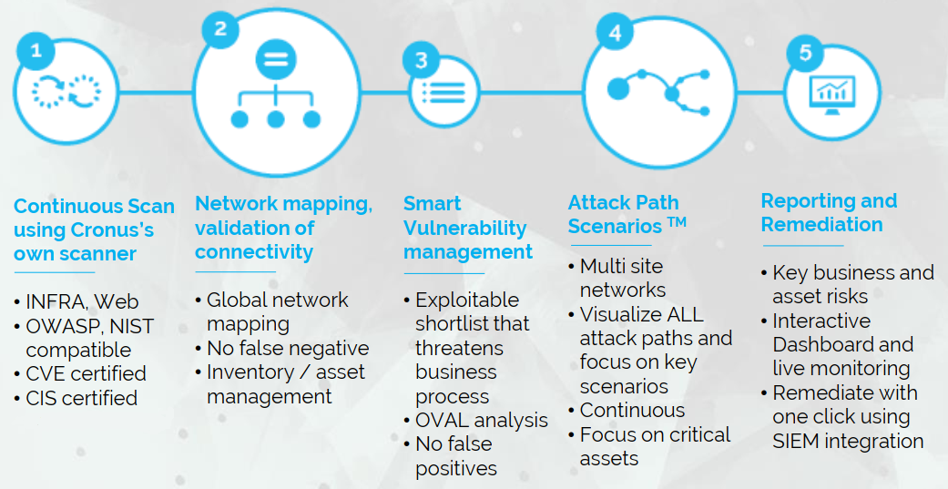
Las 5 diferencias - únicas de CyBot Pro

Slide 13
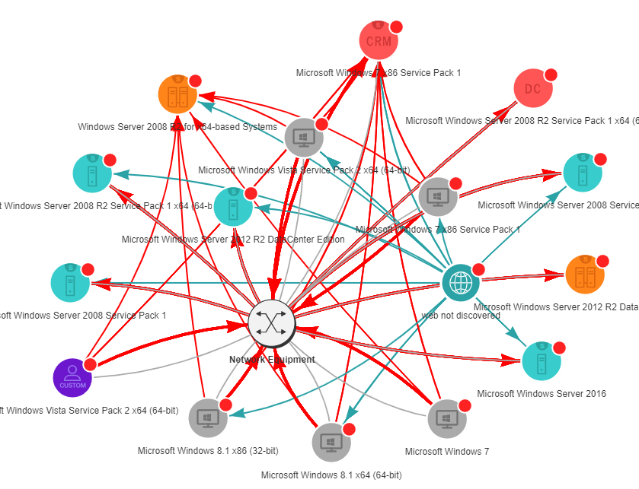
CyBot detecta multiples vectores de ataque que pueden ser explotados contra el mismo objetivo 24x7
Esto puede ser una combinacion de vulnerabilidades a traves de diferentes controles que llevaran a un compromiso exitoso por parte del atacante

Slide 14
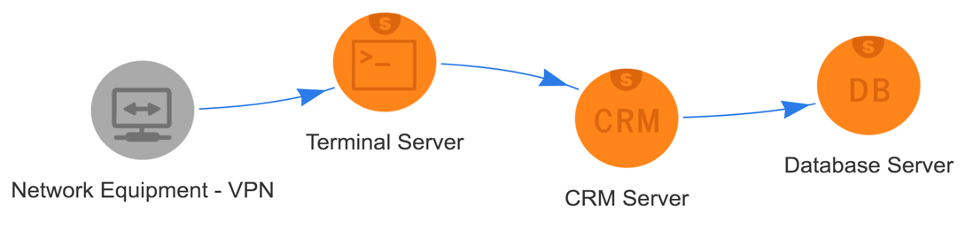

Que hace a CyBot diferente? IA para ir un paso adelante de los cybercriminals
Remedie los host y activos realmente explotables

Slide 15
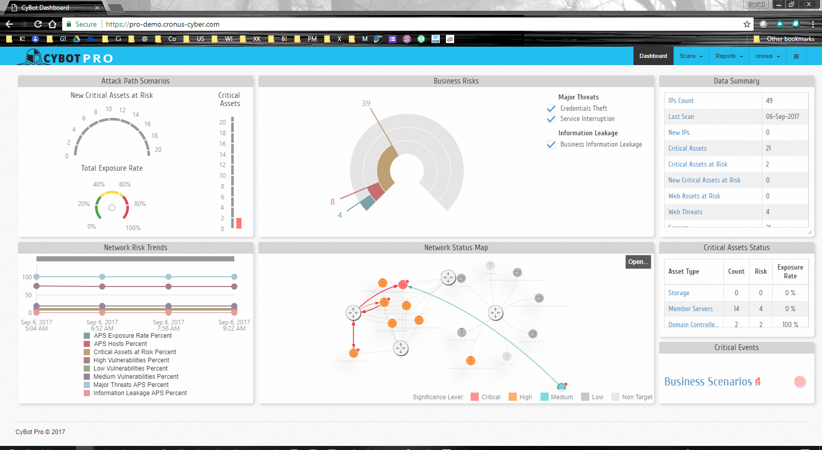
Demo
Tablero principal de Cybot
Notes:
This dashboard maps a fictitious client’s network.
From upper left to lower right on this dashboard we have the Attack Path Scenarios, Business, Risks, Data Summary, NW Risk Trends, Network Status Map, Critical Assets Status and Critical Events
So, here on the right in Data Summary we have all the technical information like the number of IPs discovered, when the last scan was run, a little lower the number of servers and workstations.
This middle section is Business Risks. When you hover over any of these you can see what percentage each threat is, like in this case 39% of total threats of Business Information leakage.

Slide 16
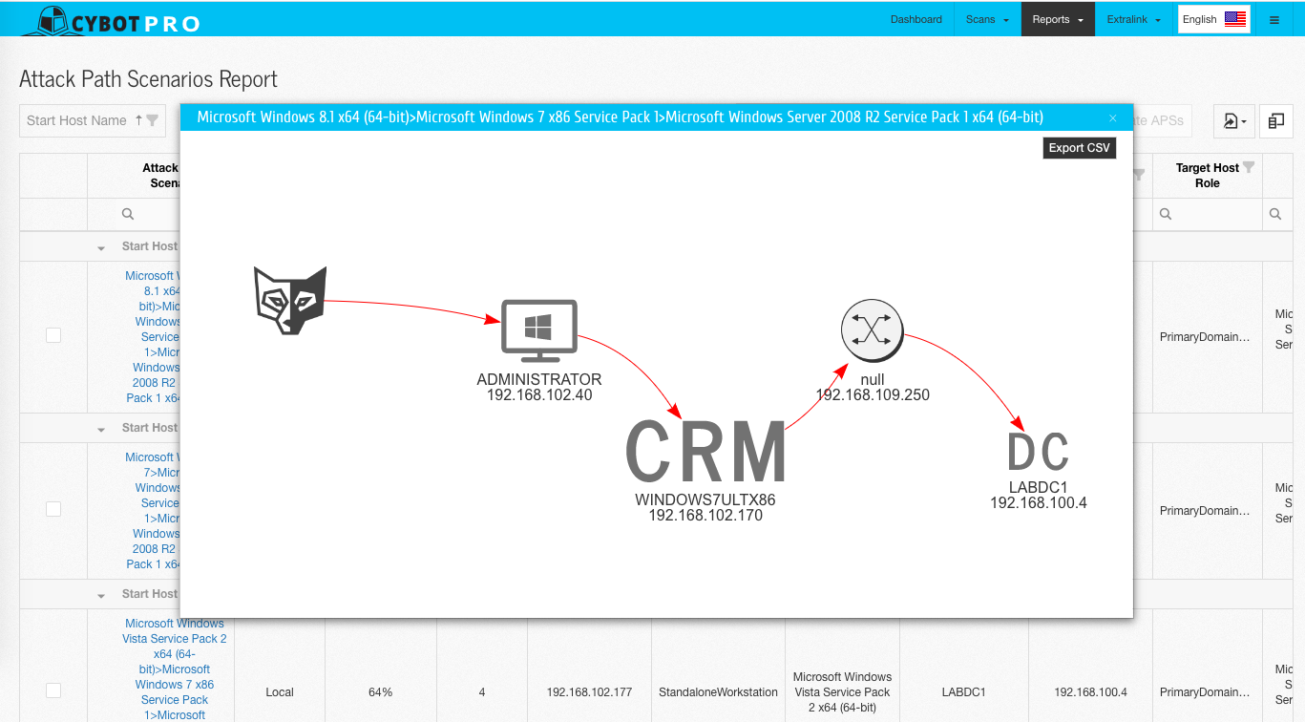
Demo

Slide 17
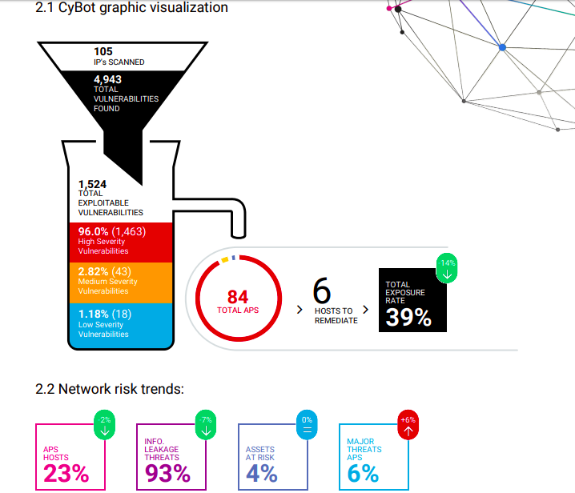


Demo
Ejemplo de un grafico generado con la funcionalidad de Resumen Ejecutivo

Slide 18




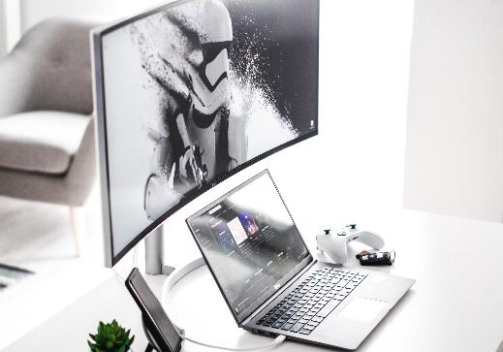
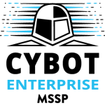
Ediciones de Cybot
Maneja y agrega
multiples CyBot Pros
Consola Maestra
Global Attack Path Scenarios
Managed Security Service Provider
Solución Multi-Tenant
Analizar múltiples
clientes
Virtual Appliance
Descubre
Perfila
Automatiza Pen Test
Calcula los APS
Licenciado on premise
Licenciado SaaS on demand
Instale cuantas CyBotPro necesite, el precio es por cada IP

Slide 19

HARMONY IoT
Porque el peligro esta detras de las cosas mas inocentes
Notes:
Harmony IoT lives in the Pre-Attack and During-the-Attack phases.

Slide 20


Comencemos mirando alrededor…
Notes:
Let’s begin by taking a look around us…
We’re sitting in a typical conference room…
Please try to count the number of IoT and Smart Connected devices in this area…

Slide 21










Comencemos mirando alrededor…
Notes:
… Now you are definitely aware to the fact that they are so many IoT and Smart Connected devices in this area, such as:
Bluetooth keyboard / mouse, mobiles, Smart TV, wearables etc.

Slide 22
















30B
Dispositivos Conectados
Notes:
The world is full of connected devices…
All in all, we are surrounded by 30 billion connected devices… and the forecast is in between 30B to 50B connected devices by the end of this year!

Slide 23


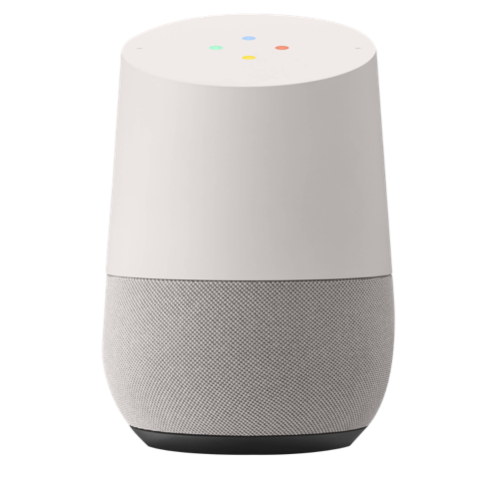

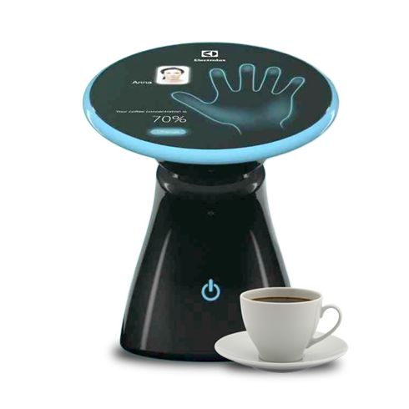
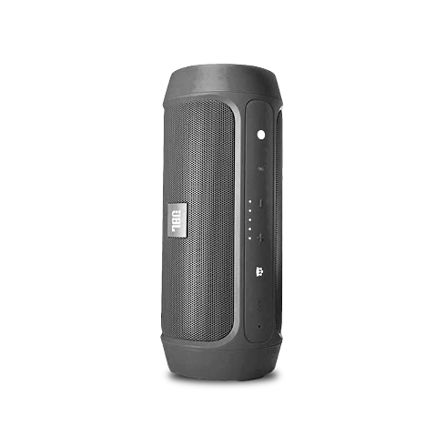
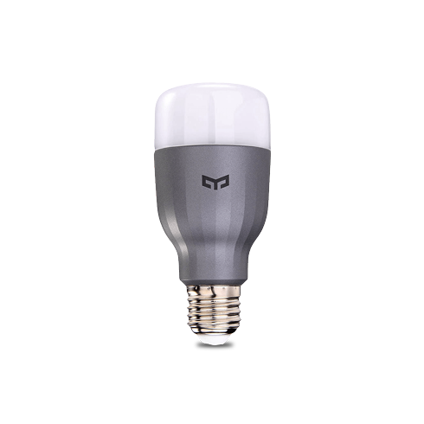
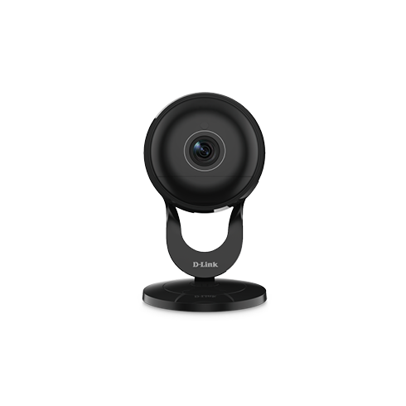
SE VEN MUY INOCENTES
Notes:
Some of these devices are permanently located in your office…and some come in and out with employees and guests…
Many of them are there to help your business run smoother and more efficiently… and they seem to be so innocent

Slide 24


NO TANTO
Unprotected storage
Vulnerable web/
mobile/cloud interface
Hardcoded backdoors
Insecure pairing procedures
Unencrypted communication
No security patches
Notes:
But aside from doing all the amazing things they do, making our business and life at work easier and more efficient, these seemingly innocent devices are NOT so innocent…
We see many devices with minimal to no security and large number of vulnerabilities, for example:
No protection on their storage
Hardcoded backdoors for remote maintenance
No encryption on their communications
Default (or factory) pairing codes
As well as no security patches
…that’s what makes connected devices the most vulnerable machines connected to your networks
… and the perfect door to the most sensitive assets of the organization

Slide 25

Espias rusos capturados atacando redes WiFI en Holanda
Picture extracted from https://www.theguardian.com/world/2018/oct/04/how-russian-spies-bungled-cyber-attack-on-weapons-watchdog
Notes:
We had a famous case of Russian spies caught while they are attacking WiFi networks owned by a research center in The Netherlands few months ago.
This is a picture extracted from The Guardian – it provides a view on their van… parking near by the building
… including WiFi antenna, computers, bag of batteries and more
… The Wireless space makes it so easy to access their infrastructure and cause a real damage

Slide 26
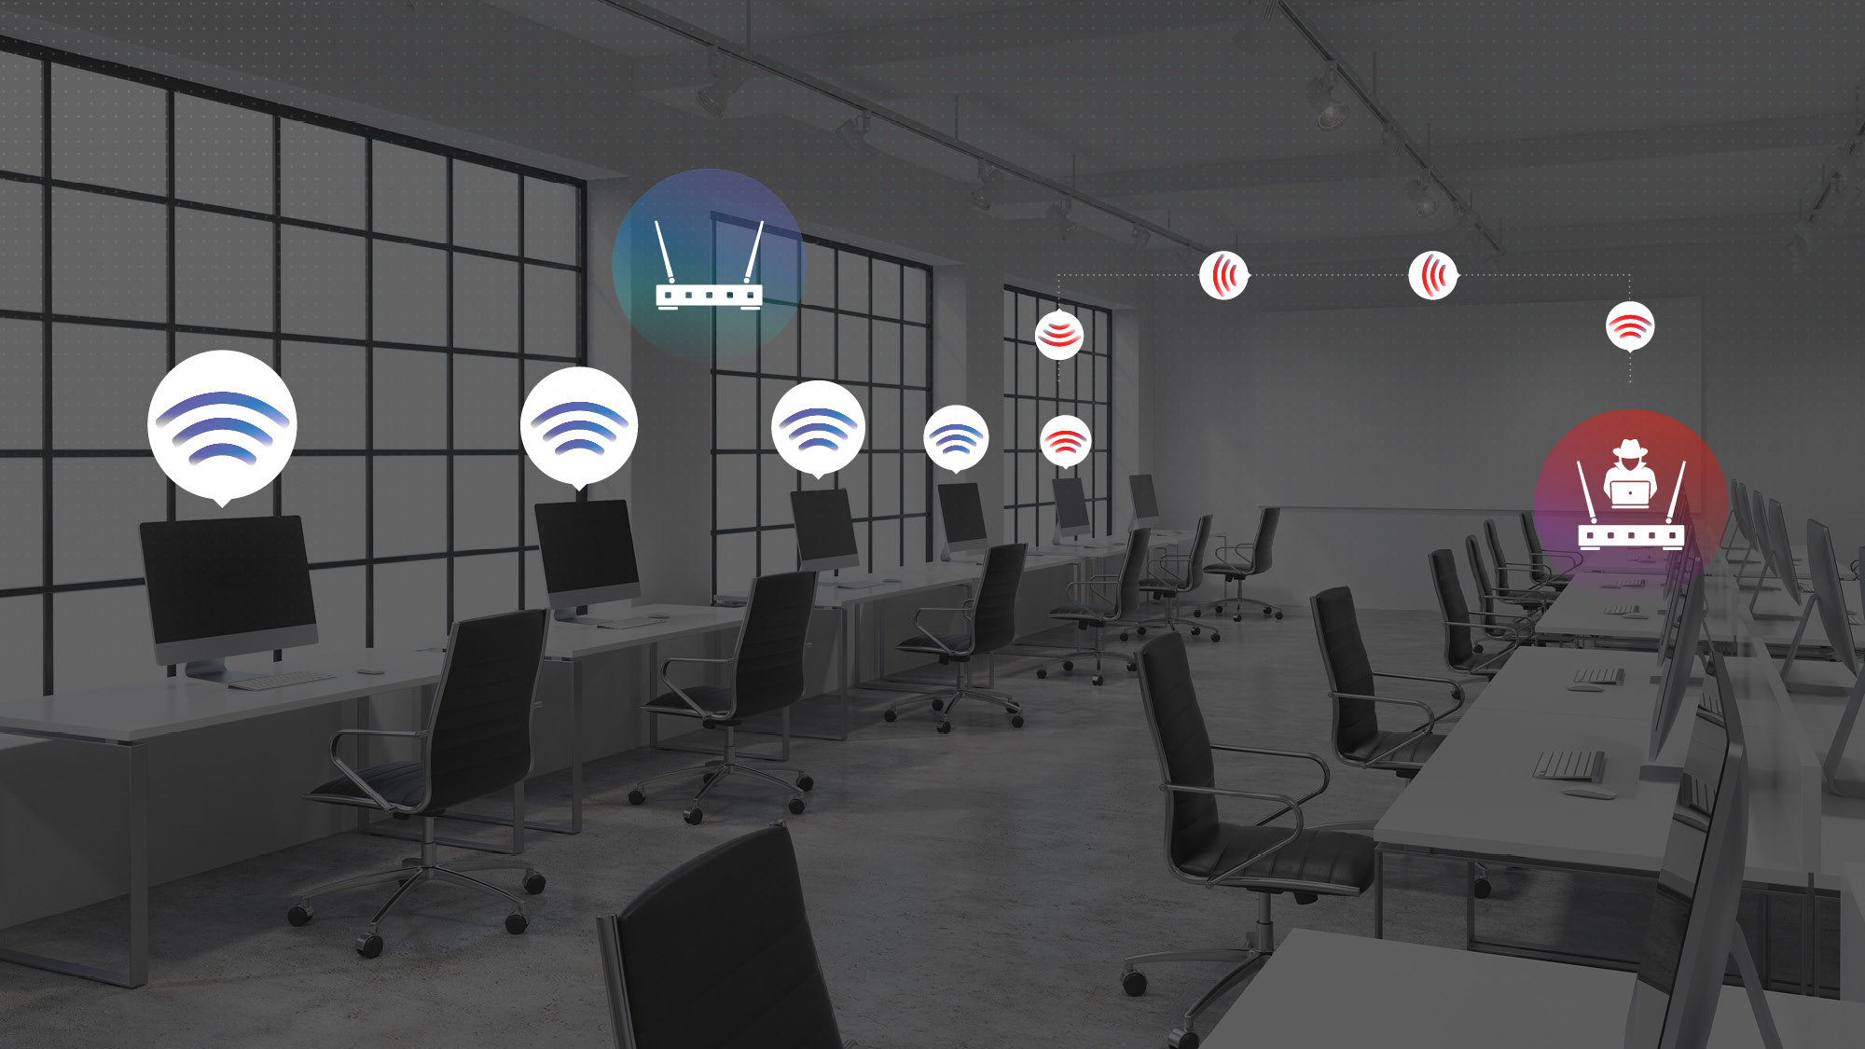
ROGUE AP
Notes:
Rogue AP - attackers are parked outside the office, running a malicious AP pretending to be enterprise’s wireless network.
An innocent user unknowingly connects to the AP
…attackers MITM (Man-In-The-Middle) his credentials for the web portal and use them to gain privileges on the corporate networks

Slide 27



Harmony IoT
Provee total visibilidad
de todos los dispositivos conectados
Apalancandose en data science para asegurar la deteccion indicada de actividades maliciosas
Mitigando las amenazas y neutralizando actividad maliciosa en tiempo real
WiFi (2.4 & 5.0)
Bluetooth
Bluetooth Low Energy
WiFi (2.4 & 5.0)

Slide 28

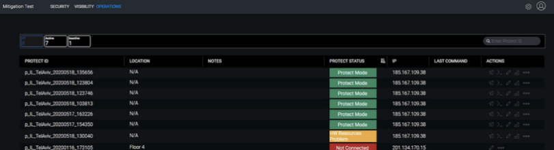
COMO FUNCIONA – Es muy sencillo adicionar las defensas de H-IoT a su infreaestrucura de ciberseguridad para obtener la visibilidad y proteccion que necesita para vigilar la actividad de los dispositivos inteligentes conectados en su ambiente.
Harmony IoT
Smart Protectors
Continuamente detectan y monitorean todos los dispositivos inteligentes conectados
Despliegue los sensores en su ambiente para entender que esta sucediendo en su espacio
Opera completamente independiente, out-of-band, asi que no necesita agentes ni actualizaciones de que preocuparse
Harmony IoT
Cloud Service
Aplica tecnicas de Inteligencia Artificial (Al), que combina con algoritmos de machine learning y big data, para continuamente aprender sobre el ambiente y perfiles de sus dispositivos inteligentes conectados
Inicia respuestas automatizadas de mitigacion segun sea apropiado, de acuerdo a las politicas del usuario

Slide 29
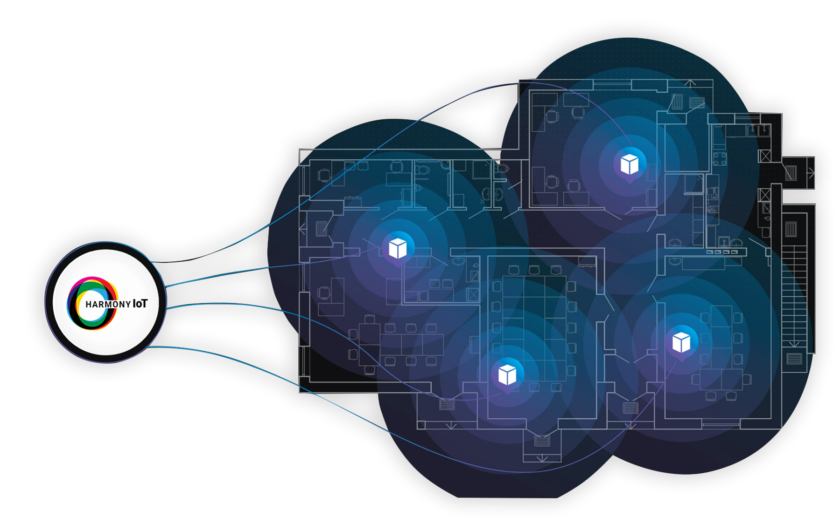
Harmony IoT

Slide 30





Productos: Cyberbit
Cyber Range: On Premise
Cyber Range: Cloud
Excelente complemento a servicios de ciberseguridad
Varios modelos de licenciamiento y precios
Notes:
Cyberbit lives in the Pre-Attack and Post-Attack phases.

Slide 31



Sobre Cyberbit
Fundada en el 2015
Emplea mas de 150 personas
Oficinas en US, Europa y Asia
Inversion de US$70M del Charlesbank en 5/2020
Top-Tier – Inversionistas:

Slide 32
Que es Cyberbit Range?
Cyberbit Range es el único simulador hiper-realistico para entrenamiento practico de profesionales en ciberseguridad

Slide 33
Cual es la promesa de valor?
La simulacion hyper realistica de Cyberbit provee de la mas cercana experiencia a un posible ciberataque en el mundo real .
Como resultado, es la forma mas efectiva de entrenar y preparar los equipos de ciberseguridad y como reaccionar ante un ataque real

Slide 34






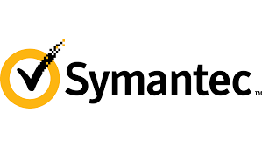



Una Experiencia Hyper-realistica de un Ciberataque
Es la unica plataforma de entrenamiento que provee los tres pilares:
Entrene con las herramientas de seguridad mas usadas
  Infraestructura corporativa
Financial, Military, Power plant,
Oil & gas…
Simulando ciberataques de la vida real
Dragonfly, Wannacry, Heartbleed, Fileless attacks, SQL Injection, Watering hole…

Slide 35
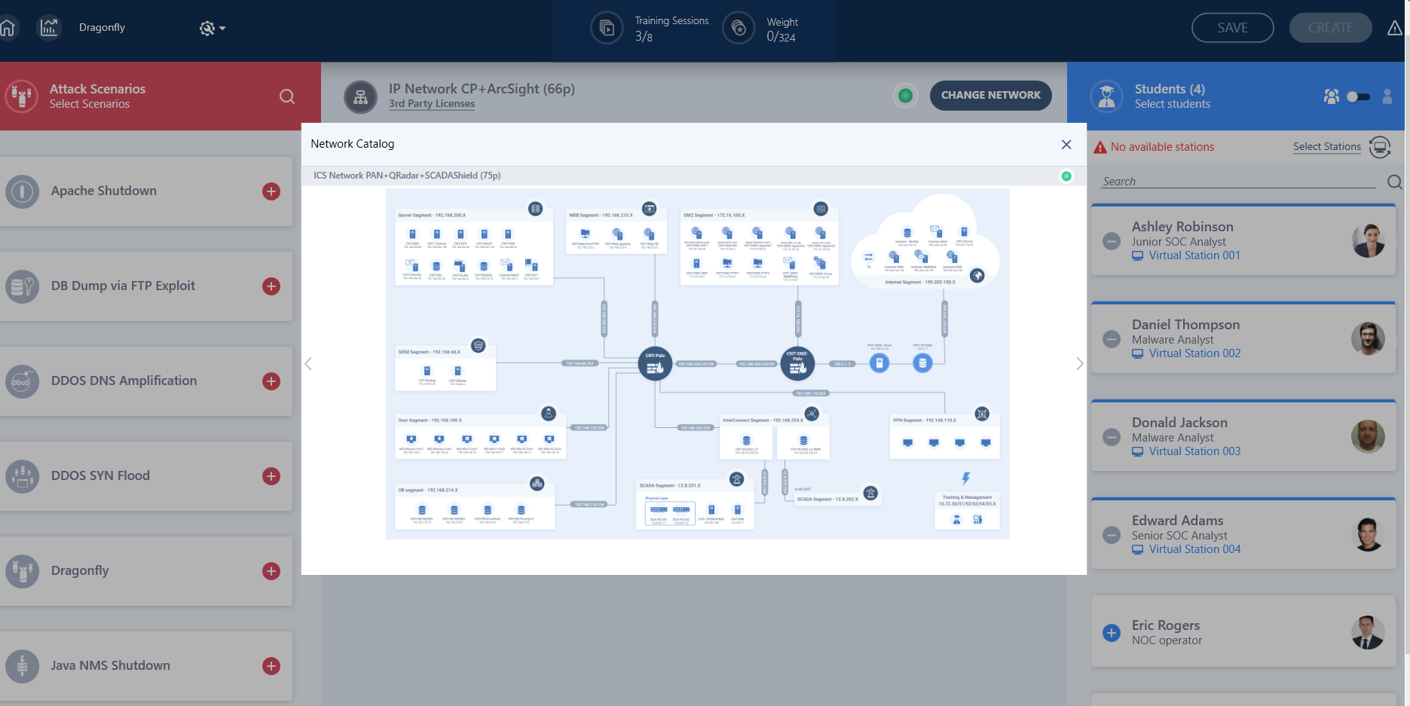
Espejo de la infraestructura de red corporativa

Slide 36
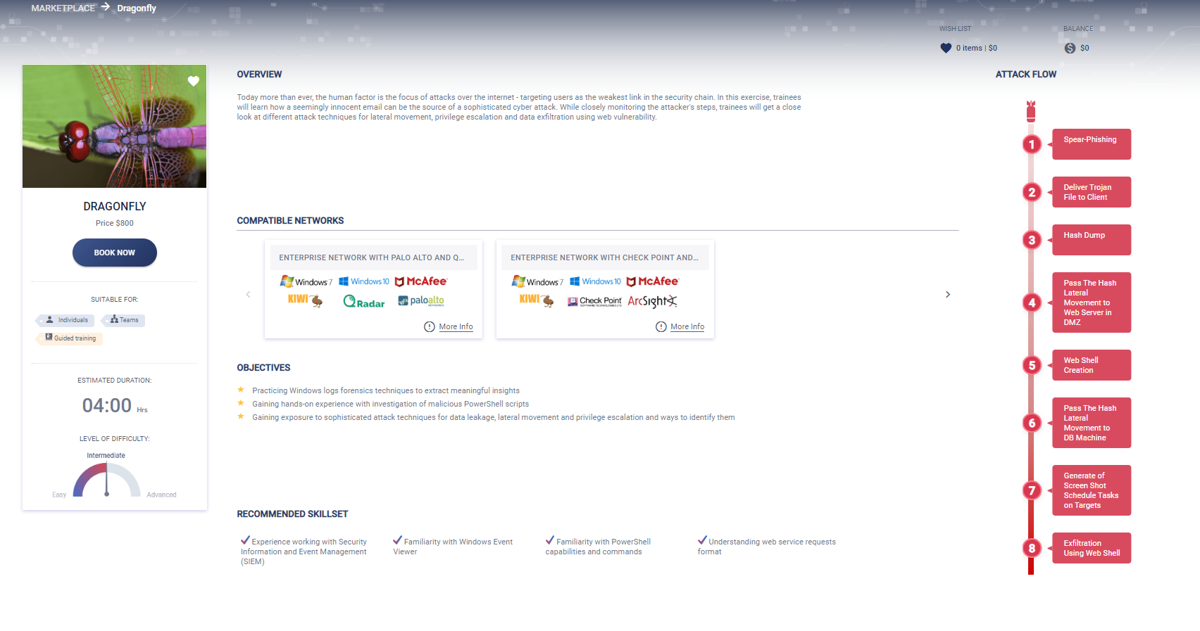
Market-leading security tools
Simulating Live Cyberattacks
Experience the entire attack as it unfolds, start to finish

Slide 37





Lo más cercano a un ambiente de ciberataque real
Instructor (optional)
Virtualized Corporate Network
Over 60 Components
Automated Attack Generator
Traffic Generator
Simulated
internet
Web Server
User PC
Firewall
Email Server
Proxy Server
Firewall
Router
User PC
Desktop Linux
Switch
Bridge
Switch
Database
Advanced SOC Training Scenarios
Entry-Level SOC Training Scenarios
Advanced SOC Training Scenarios
Pentesting Training Scenarios
Virtualized SOC
Real-World Tools

Slide 38
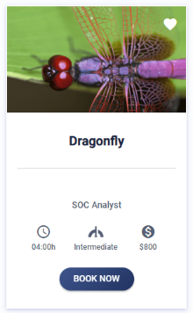
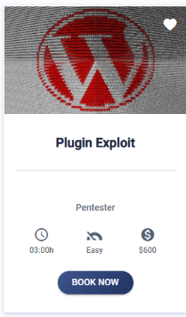
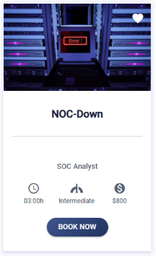
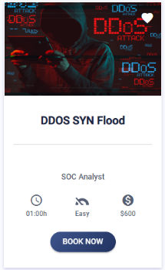
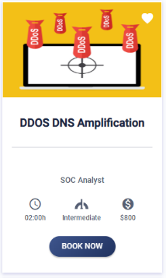
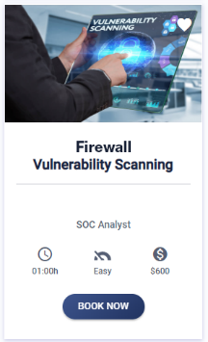
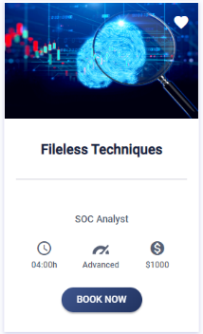
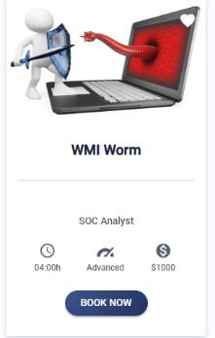
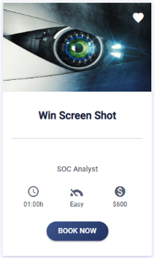
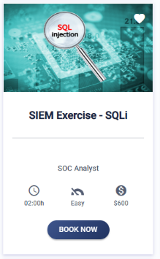
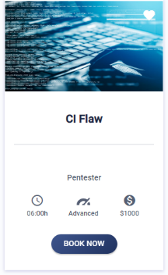
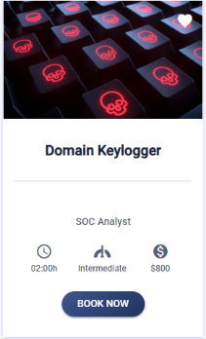
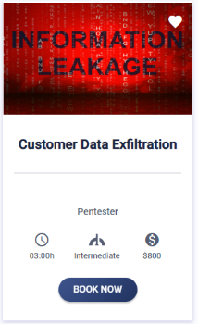
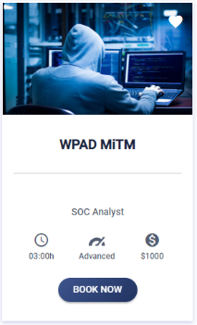
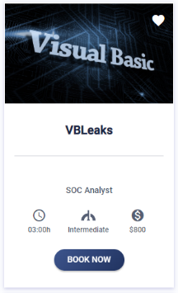
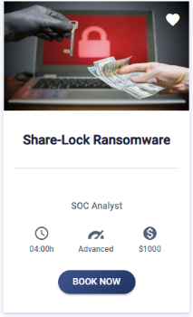
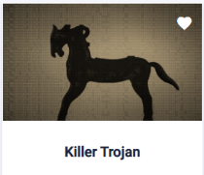

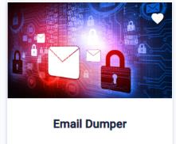
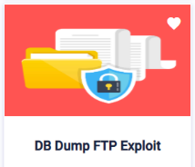
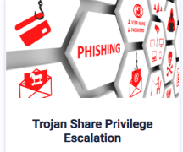
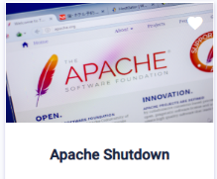
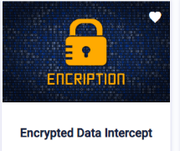
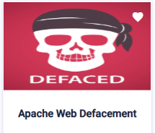
Dozens of Simulated Cyber Attacks that Prepare Your Team
Ejercicios de entrenamiento para su eleccion

Slide 39
Dozens of Simulated Cyber Attacks that Prepare Your Team
Escoja su nivel de entrenamiento
Avanzado
Principiante

Slide 40
Dozens of Simulated Cyber Attacks that Prepare Your Team
Seleccione como quiere hacerlo
Grupo
Individual

Slide 41
Dozens of Simulated Cyber Attacks that Prepare Your Team
Decida en cual equipo quiere “jugar”
Equipo azul
Equipo rojo

Slide 42
Dozens of Simulated Cyber Attacks that Prepare Your Team
Amplíe sus conocimientos
Practica en producto
Ataques tipo End-to-End

Slide 43
























La plataforma de entrenamiento en ciberseguridad mas usada a nivel mundial
Major Police Dept.
Top-3
US Airline
Top-5
US Bank
Top-3
US Airport
Top-5
US Airline

Slide 44
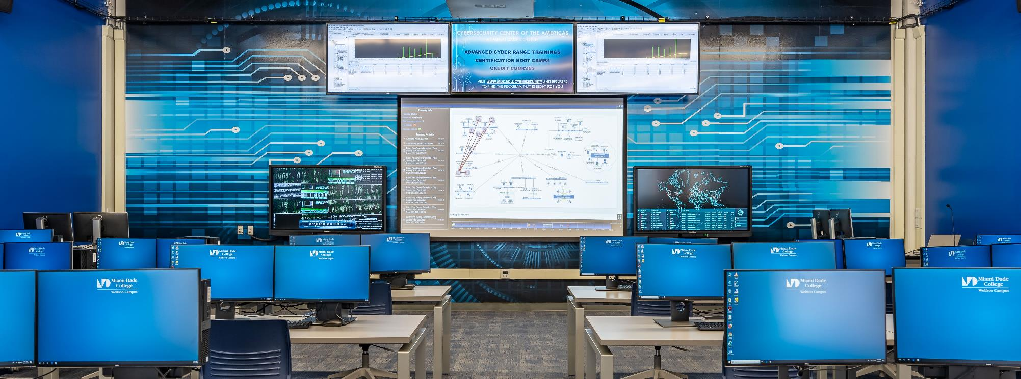
Una Instalacion Cyber Range
Cybersecurity Center of the Americas
Miami Dade College
Notes:
This is one of our cyber ranges at Miami Dade college, the largest undergraduate

Slide 45



Modelos On-Prem y Cloud
Cyberbit Cloud Range
Cyberbit On-Prem Range
Cyber range
as–a- service
Instant Access, Anytime, Anywhere
AWS Hosted
Customize networks & tools
Customize
scenarios
Practice OT
attacks
Notes:
You have 2 options to use the range. One is to access our cloud range on AWS. It’s instant access – so you log in and start training.
The other option is buying an on-prem range. What’s unique about it is that besides all the great capabilities of the cloud range you can customize the network and the scenarios, so you can, for example, use your own SIEM brand and configure the infrastructure to mirror yours. Let’s discuss the difference between the 2 options.

Slide 46

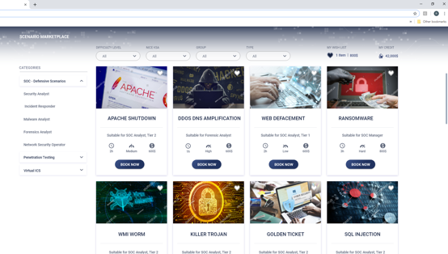



Incursione en un SOC Virtual, en cualquier momento, en cualquier lugar
1
2
Browse the Marketplace and Select Your Scenario
Select Network
and Security Tools
3
4
Book Your Time Slot
Join on Time and
Start Training

Slide 47



Alguna pregunta final?
Gracias!

