Slide 1
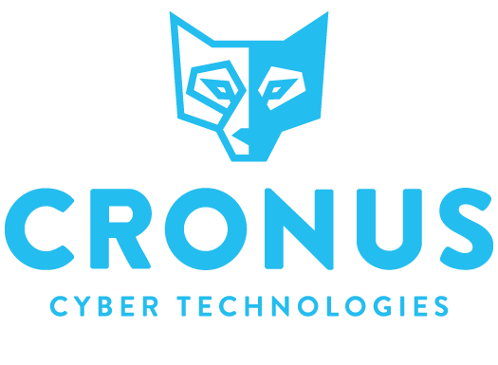
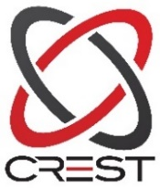







CREST Certified
Penetration Testing Vendor
Take Control, Get CyBot
PRE ATTACK SOLULTION
AT ITS BEST
Daniel Yaakov
daniel@cronus-cyber.com
www.cronus-cyber.com
Notes:
Cronus is a spinoff from an Ethical Hacking, Penetration Testing and Risk Assessment company.
We detect several gaps or needs in the Cyber Security market, and decided to provide a solution for them.
Cybersecurity 500
https://cybersecurityventures.com/cybersecurity-500-list/#home/viewdetails/54ce56316a23917a54b08a7e/
CBInsights
https://www.cbinsights.com/research/cyber-insurance-risk-scoring-startups/
CDM MSSP
https://www.prnewswire.com/news-releases/cronus-cyber-technologies-wins-cyber-defense-magazine-infosec-awards-for-most-innovative-managed-security-service-
provider-mssp-613603153.html
CDM cybersecurity leader
https://www.prnewswire.com/news-releases/cronus-cyber-technologies-named-2017-cyber-defense-magazine-cyber-security-leader-650230893.html
Cronus on Momentum watchlist of top 10 cyber companies
https://cronus-cyber.com/watchlist/​

Slide 2
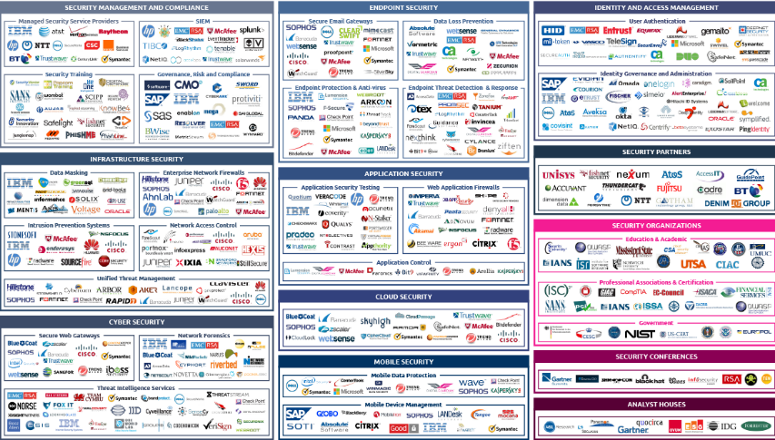


Security Industry spends over 70 Billion $
How Secure am I ???
Notes:
Solo systems
Multiple systems from a variety of vendors
Organizational complexity
unique management way
too many alerts
what’s the focal point?
Hackers continue to innovate ,reusing innovations ,Hackers always win
It’s a simple question that every CISO or organization has a hard time to answer

Slide 3





The cyber security market is divided into 3 levels
Pre Attack
During Attack
Post Attack
Penetration Test
Vulnerabilities Scanners
Automation
Antivirus
EDR
Firewall
IPS\IDS
Forensics Tools
Logs
Notes:
There are 3 main segments, as shown on the slide
CyBot is in the Pre-Attack segment, and is a preventive/predictive solution, with 2 registered patents.

Slide 4





Problem with current Pre Attack Solutions
Drowning in alerts, not effective in protecting critical assets / business processes
Problem
Pre Attack
Human PT
Human
Inefficient
Local
Limited in time and scope
Vulnerability Scanners
False positive
Not in real time
Not global
No correlation to business processes
Notes:
Pentesting is currently the only sure way to validate if an organization is susceptible to attack, and how much
Penstesting is expensive
Limited in scope –no global cover
Cost=time based=scope based=never cover the whole organization => you get what you pay for
Pentesters employ various vulnerability scanners or management tools = main issues: prone to crash systems or networks & high percentages of false positives
Pentesting is periodical, and not frequent enough.
This leaves long periods of time when the organization can be under attack or open to attacks.

Slide 5
Problem with current Pre Attack Solutions
Drowning in alerts, not effective in protecting critical assets / business processes
Problem
Pre Attack
Human PT
Human
Cost
Inefficient
Local
Limited in time and scope
Vulnerability Scanners
False positive
Not in real time
Not global
No correlation to business processes
Notes:
100 new vulnerabilities are published daily
The products used usually overload the organizational networks, so scheduled scans are required.
They provide reports with a high percentage of false positives
They are local solutions but protecting one site is not enough
Hackers always wins

Slide 6


CyBot
Save time & money
Increase security by focusing on remediating vulnerabilities that are a part of a validated
attack path to a business process or critical asset
All vulnerabilities
Your vulnerabilities
Exploitable Vulnerabilities
Part of a Critical Business Process
Part of an Attack Path Scenario™ (APS)
Identify Global Attack Path ScenariosTM
Infrastructure and Web Scanning
Effective remediation, focus on threats to business processes
Notes:
We need a continuous solution with a growing knowledge base than can be updated
CyBot was developed to think like a hacker and display the potential APS that a hacker can exploit.
CyBot will provide a Smart Vulnerability Management platform which will help both Security and IT teams to prioritize their remediation efforts and build a strategically tailor-made plan for the company/
To that effect, we developed 2 patents:
1. One is our scanning technology, which has a very low network footprint (less than 7%), and is able to minimize the number of false positives displayed, by assessing and validating the vulnerabilities, by connecting with credentials to the various devices on the network, and by incorporating OVAL – the Open Vulnerability Assessment Language into the scanning engine.
2. The Reasoning Engine, which makes CyBot think like a hacker, and employ hacker’s techniques to perform Automated PT and calculate the Attack Path ScenariosTM.
Finding valid Attack Path Scenario is performed by an algorithm that was developed by us, and in fact, imitates how hackers really work.
CyBot Pro is an on premises solution, which performs 24/7 vulnerability assessment and pen testing in real time.
It contains the accumulated hacking/Pen testing knowledge of the company’s employees + CVE’s, information from the vendors themselves and more.
So, to sum up what the CyBot Solution is – Smart Vulnerability Mgmt. platform validated by Continuous Automated Pen testing

Slide 7
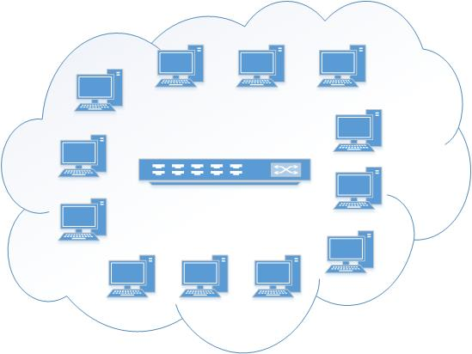
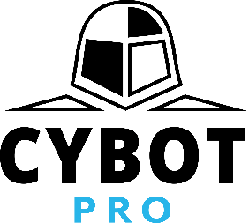


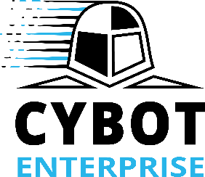
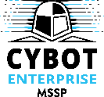
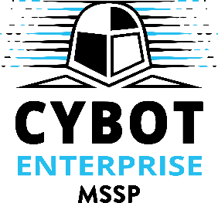
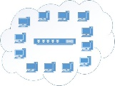
Product Suit
The core engine
Discovery
Profiling
Automated Pentesting
APS calculation
Manager and aggregator of data from multiple CyBot Pro instances.
Central management console
Global Attack Path Scenarios
Managed Security Service Provider
Multi-tenant solution
Offer monitoring and remediation

Slide 8
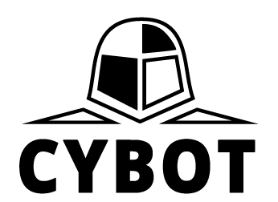

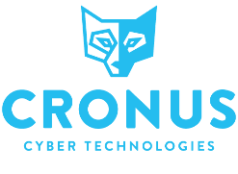
Cronus and GDPR
Date of effect: May 25 2018
General scope: Protect personal data of EU citizens, globally.
Failure to comply will result in fines of 20 Million Euros or 4% of turnover, which ever is higher.
GDPR recommends regular penetration testing and vulnerability assessment to assess the effectiveness of your security measures.
Notes:
Our solution will cover your security posture with regards to GDPR requirements in terms of preventing an attack that may jeopardies privacy of your customers

Slide 9

How can Cronus CyBot help you comply?
Automated Pen Testing (CREST approved) and Vulnerability Management (CVE MITRE approved)
Cutting edge, award winning technology
Highly effective in reducing risk of breach to your sensitive data
Adoption of proper processes
Global Coverage
Notes:
We are very efficient in reducing the risk
Maybe we can’t stop the infiltration but we can narrow down and mitigate the attack from move laterally or heading the crown jewels

Slide 10
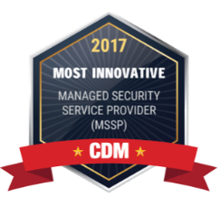



Fully commercial, award winning product
Media & Awards
“CRONUS IS ONE OF 12 TECH STARTUPS TRANSFORMING CYBER AND THREAT REMEDIATION INDUSTRIES”
“CRONUS IS THE MOST INNOVATIVE MSSP SOLUTION”
“CRONUS IS ONE OF THE HOTTEST
CYBER COMPANIES TO WATCH IN 2017”
“CRONUS IS 2017 CYBER SECURITY LEADER” BY CYBER DEFENSE
MAGAZINE
Notes:
CBInsights
https://www.cbinsights.com/research/cyber-insurance-risk-scoring-startups/
Cybersecurity 500
https://cybersecurityventures.com/cybersecurity-500-list/#home/viewdetails/54ce56316a23917a54b08a7e/
CDM MSSP
https://www.prnewswire.com/news-releases/cronus-cyber-technologies-wins-cyber-defense-magazine-infosec-awards-for-most-innovative-managed-security-service-
provider-mssp-613603153.html
CDM cybersecurity leader
https://www.prnewswire.com/news-releases/cronus-cyber-technologies-named-2017-cyber-defense-magazine-cyber-security-leader-650230893.html
Cronus on Momentum watchlist of top 10 cyber companies
https://cronus-cyber.com/watchlist/​

Slide 11
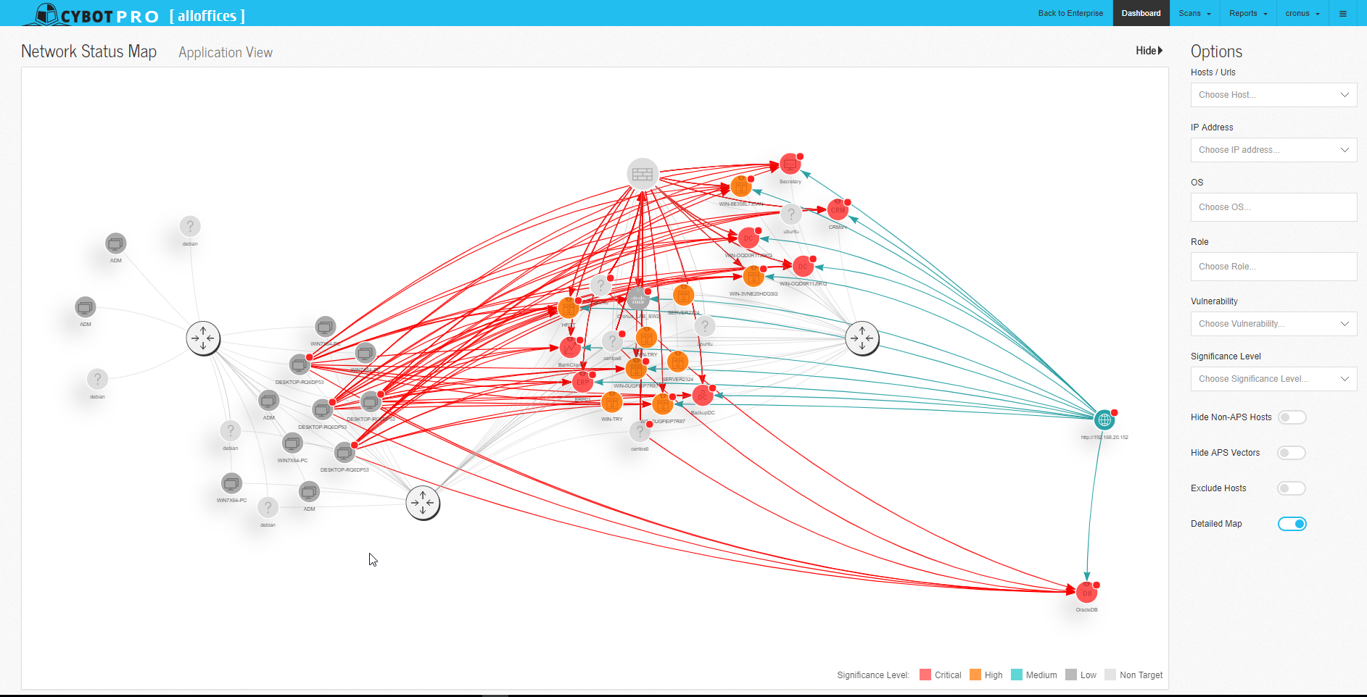
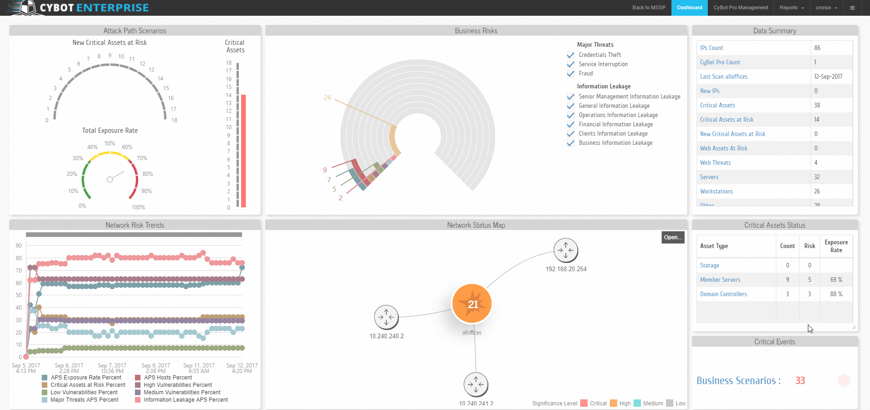
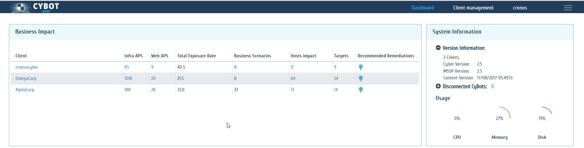
See CyBot in action!
Notes:
Link to Demo environment

Slide 12
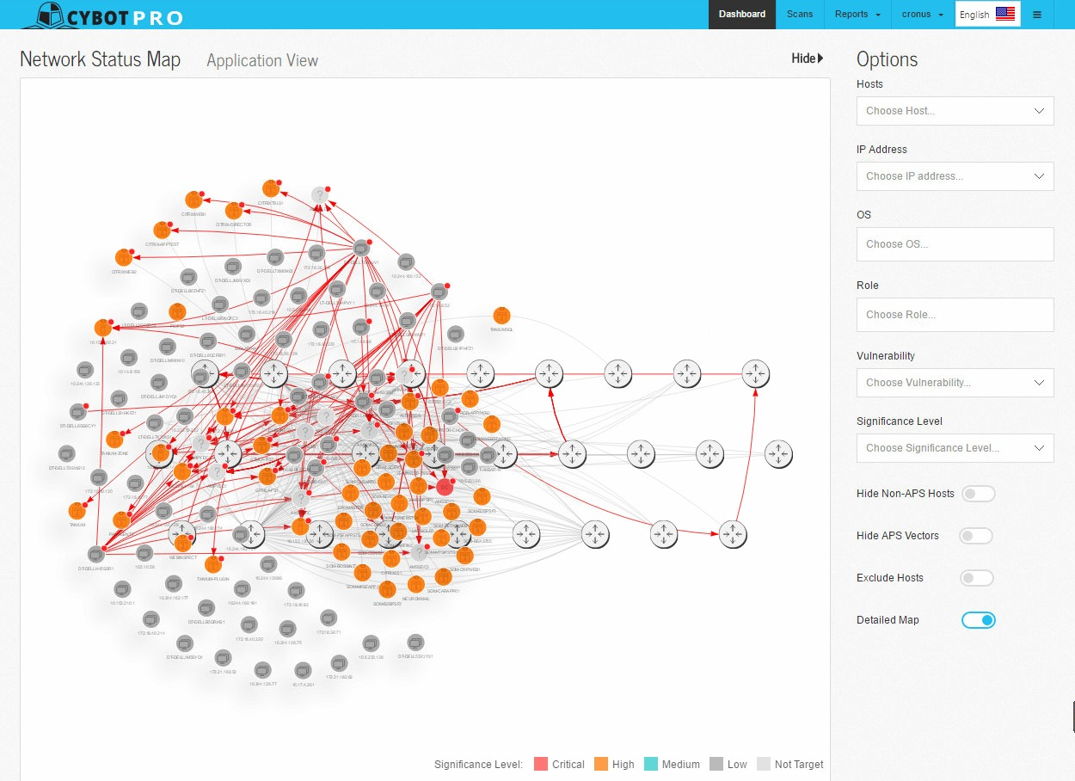
Case Study
CyBot Attack Path Scenario™ map
Global, continuous threat overview
This map shows the network segment scanned by one CyBot
CyBot can scan multiple networks and also showcase “Global Attack Path Scenarios”TM
Main Junction to 13 APS
Target of 4 APS
Router
1
2
3

Slide 13
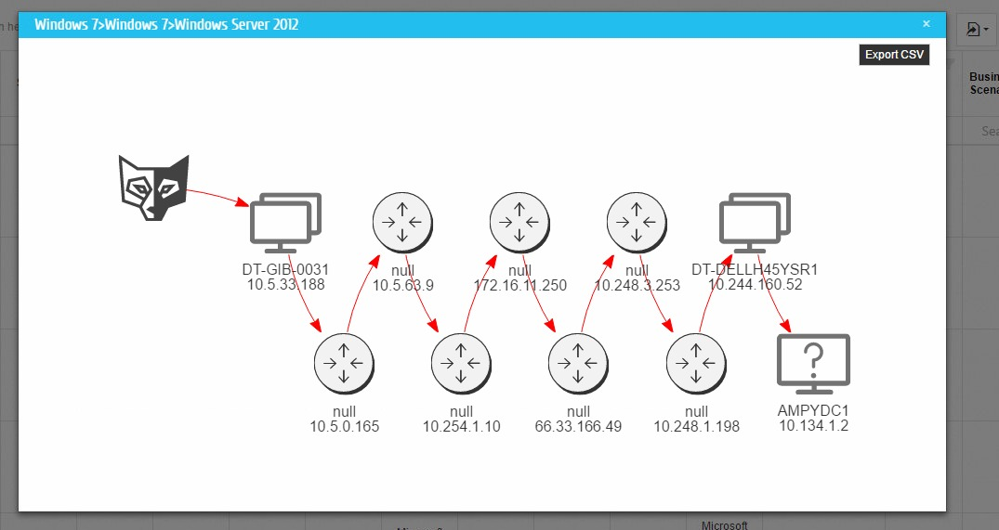

Analysis
Specific Attack Path Scenario (APS) TM
Attack Path ScenariosTM
One attack path showcases a very complex and validated scenario that not only shows how vulnerabilities can be exploited to threaten a business process but also that a firewall was misconfigured that allowed this path to continue.
This insight would be almost impossible to find using human ethical hackers or existing scanners.

Slide 14
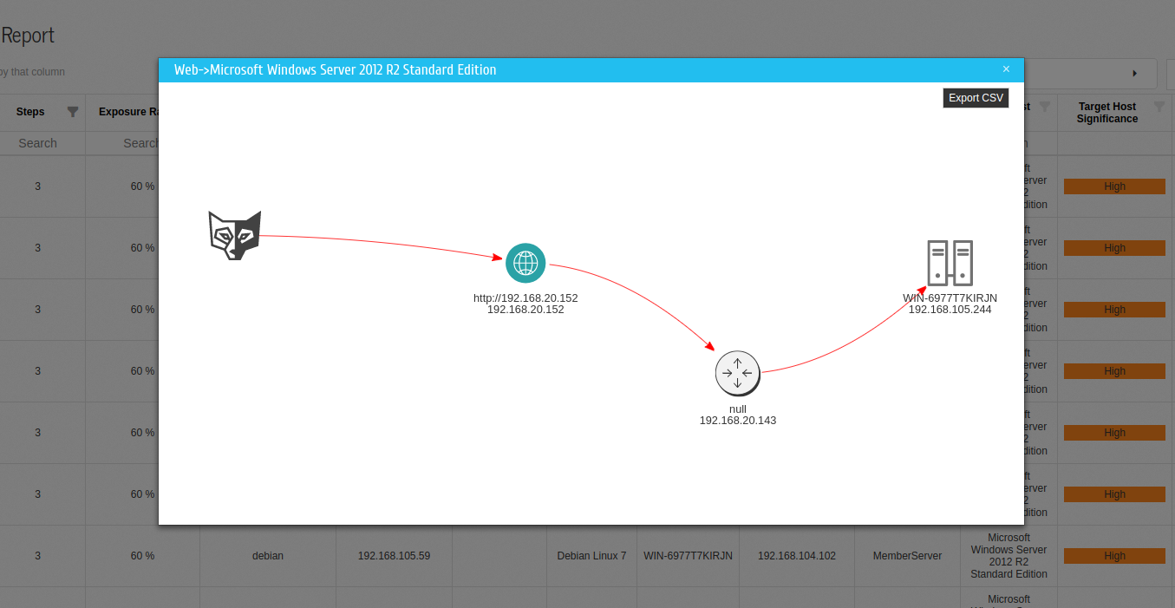
Analysis
Attack path that combines automated Web PT and Infra PT
External / Internal Capabilities
CyBot uses a holistic approach, showcasing a combined external / internal attack path that starts in the web and ends in your internal network.

Slide 15
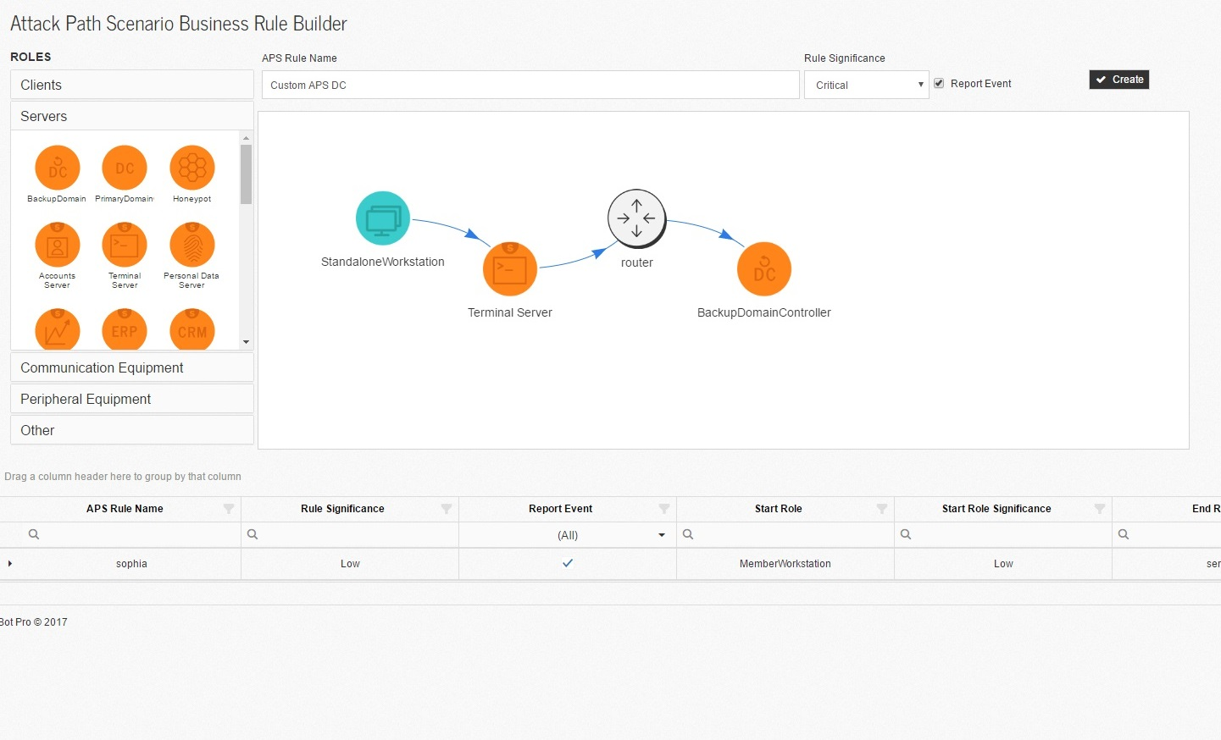
Analysis
Create your own business processes using simple drag & drop
Protect business continuity
CyBot allows the user to input their critical business processes, such as CRM, customer onboarding, billing etc and then focus on attack paths that correlate with such business processes.

Slide 16
Thank you

