Slide 1
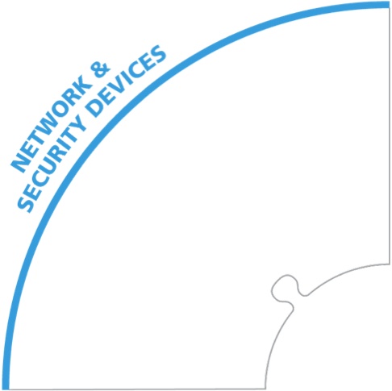
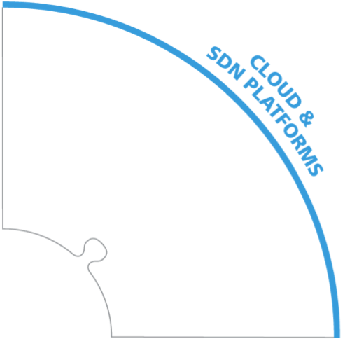
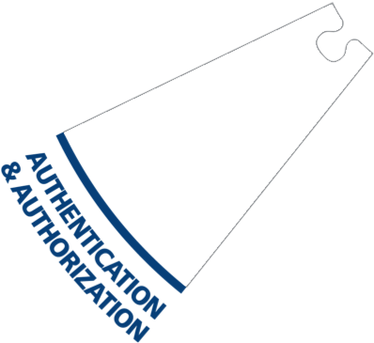
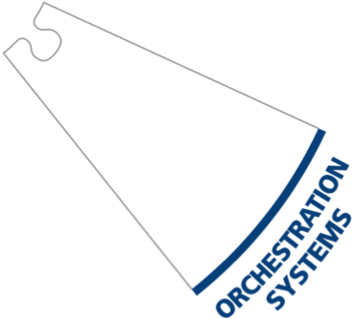
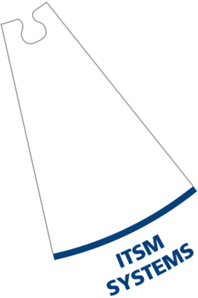
The AlgoSec ecosystem
Manage
Business Process
Integrate
For a complete list of supported devices visit www.algosec.com
Notes:
At Algosec we managing the leading physical, virtual and cloud firewalls in the market today, such as Checkpoint, Cisco, Fortinet, Juniper, AWS, Vmware, Microsoft Azure ext.
But this is not enough, At Algosec, we know our clients want their security management systems to seamlessly integrate with their whole ecosystem.
That’s why Algosec provides flexible integration with: SIEM solutions, Identity management systems, ITSM, Orchestration systems, Vulnerability Systems and much more.
Algosec also aligns with you business process, including different CRM and ERP applications.
In addition Algosec provides API’s that allows to easily integrate 3rd party systems.

