Slide 1
Complete 360 Protection
www.comodo.com
Notes:
-Thank you
Introduce yourself
Introduce SE
Is there anyone else who will be joining us today?
Recap Points (current solution?, End points? Does that include servers, desktops/laptops?, Contracts Expiration?)
Agenda (Go through a few slides to give you more information about comodo than my SE will take you through the demo)
Is there anything specifically you would like me to go over?

Slide 2
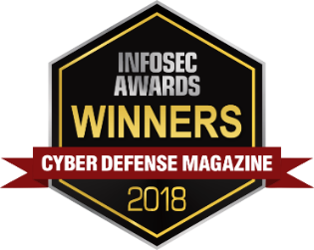
Company Profile
Industry Recognition and Awards in Cybersecurity
TWO DECADES SECURING CUSTOMERS
1300+ EMPLOYEES WORLDWIDE
Global organization with 20 years in cybersecurity
Global operation employing world-class talent to combat critical threats
1,000,000+ SCANS DAILY
250 PATENTS IN SECURITY & IDENTITY
Protecting customers worldwide from cyber threats
Continuous innovation across the gamut of cybersecurity
100,000,000+ AGENT INSTALLATIONS
$120 MILLION INVESTMENT
Installed agents across 100 million+ endpoints worldwide
Fully funded R&D for technical and commercial innovation
Notes:
1. There are a few things I want to point out on this slide. First, just briefly about comodo, we’re been around for 2 decades now, we were actually leaders in the SSL certificate space back in 2004 but have since then sold off that side of the company to focus on our cybersecurity division.
2. As you can see at the top here, we’ve won a few big awards in the past, more notable the Cybersecurity Excellence Awards back in 2018. And even more recently, something we’re very proud of is we became a part of the Gartner Magic Quadrant. So out of 75 players in the industry they take the top 20 and we were lucky enough to make it on there, something that we’ve been very proud to be a part of. That’s only 20 companies per vertical annually.
3. We do a million scans daily protecting our customers. And with over 100 million agent instillations you can see we do have a pretty large global footprint.
4. As you can see at the top we do also have 1300 employees worldwide, why does that matter for you? It actually provides us with the ability to provide you with 365-day 24/7 support.

Slide 3
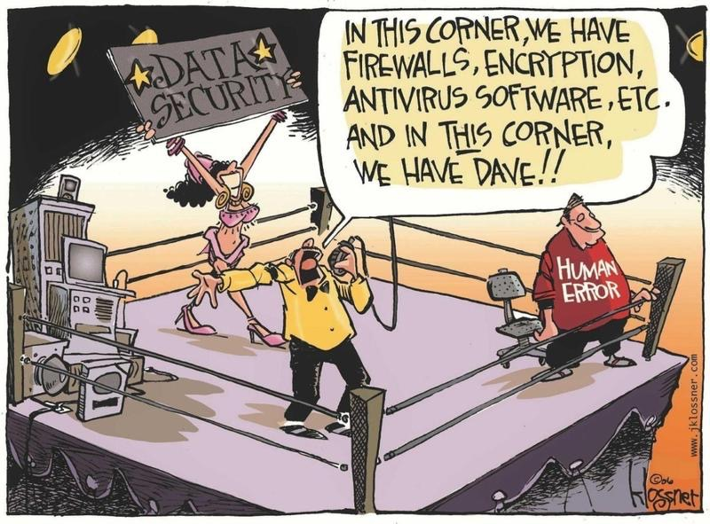
Day to Day in Cybersecurity….

Slide 4
?
Challenges of Detection Methods
Bad indicators are not always identified
NO ONE CAN STOP 100% OF THREATS FROM COMING INTO YOUR NETWORK
Allow Unknown
Threats to Enter
Reliance on previously known bad indicators
0%
1%
99%
100%
Anti-Virus
HIPS – ANTI-X
Behavioral Analysis
Machine Learning
Undetectable Threats
1990s - 2000s
2000s - 2010s
Present
Notes:
1. We’re going to take a look at the challenges of detection methods. I’m sure your familiar with this so we’ll go through this fairly quickly. We understand that bad indicators are not always identified and I’m sure you’d agree with me that no one can stop 100% of threats from coming into your network. And really, as this threat landscape changed so did the industry.
2. So we see back in the 1990s into the 2000s just your signature based detection, with anti-virus. And as we move on we started adding to that security stack; through HIPS, Behavioral Analysis, Machine Learning, and even Artificial Intelligence today. But still, everyone is hovering at that 99% detection rate, in return we still see this 1% gap in security, which actually equals thousands of pieces of malware daily. And THAT is where comodo decided to take a bit of a different approach.

Slide 5
Not all Attackers are the Same
Differences
 | Bother | Hacktivism | Crime | Espionage | War
Objective | Access and Propagation | Defamation, Press and Politics | Financial Gain | Economic Advantage, Politics | Disrupt Operations
Example | Botnets & Spam | Destruction of website | Credit Card Theft, Ransomware | Advanced Persistent Threats | Destroy Critical Infrastructure
Directed | ☒ | ☑ | ☑ | ☑ | ☑
Type | Automated | Conspicuous | Opportunistic | Persistent | Conflict

Slide 6
Current Cybersecurity Challenges
Lack of Visibility
Flood of Alerts
Experienced Resources
Lack of Context
Increase of Tools
Business Impact

Slide 7
How can you stop the damage from an undetectable active breach?
Notes:
“Ask the question”

Slide 8
Advanced Endpoint Protection
Notes:
“Ask the question”

Slide 9
MANAGEMENT CAPABILITIES
Includes ENDPOINT MANAGER (RMM SUITE)
Remote Monitoring and Management
Remote
Control
Service
Desk
Mobile Device
Management
Monitor and manage all your clients’ devices from one central console.
Review performance data, execute remote patching, updates and service configurations to servers, desktops, applications and mobile devices.
Deploy this cloud-based, fully featured automated ticket management system to facilitate service requests, meet service-level agreements and prioritize tickets.
Deploy, secure, monitor and manage clients’ mobile devices - distribute applications, data and configuration settings and patches.
Patch Management
Unknown
File Hunter
Auto Device Discovery and Software Deployment
Mobile
Management App
Perform the highly essential tasks of continual patch monitoring and updates for Microsoft Windows, Linux, Apple MacOS and third-party software.
Useful scanner that identifies unknown, and potentially malicious files, residing on a network.
Automatically scan clients’ networks and software.
Manage customers’ tickets in real time from your mobile device.
Network Assessment
Cleaning
Essentials
Customer Relationship Management
Quote
Management
This portable client network risk assessment and vulnerability management tool is critical for you to use.
Portable computer security tools to identify and manually remove malware and unsafe processes.
Automate workflow processes, decrease processing time.
Generate professional quotes and invoices for services and equipment.
© 2020 Comodo Security Solutions, Inc. All rights reserved. All trademarks displayed on this document are the exclusive property of the respective holders.

Slide 10
traditional endpoint security

Slide 11
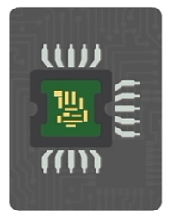
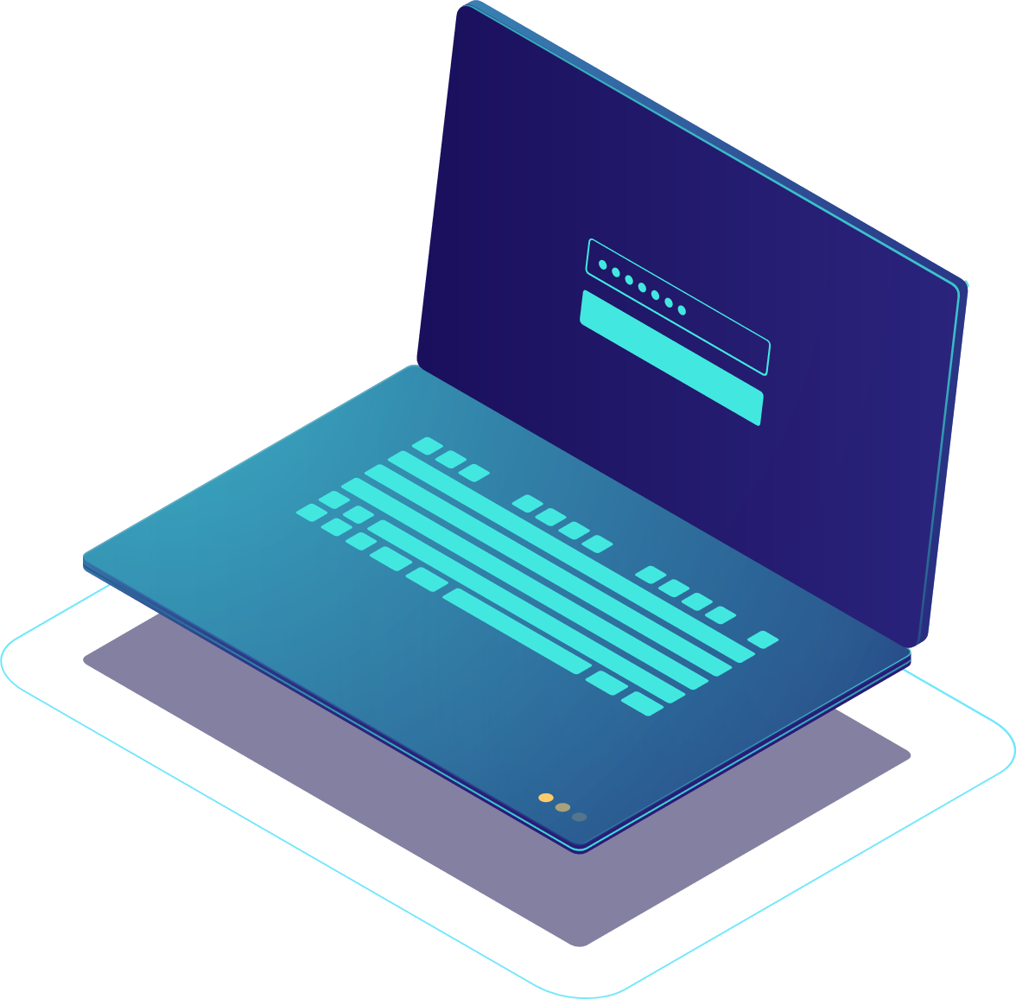
Comodo’s Auto-Containment
Containment prevents the damage
From files that bypass detection methods
Malware requires write access to critical system resources
Hard Drive
Registry
COM Interface
Ransomware overwrites company data
Malware persists by adding code to registry
Malware injects malicious code to good processes
Unknown Files
Comodo containment prevents the damage
Auto-Containment virtualizes those same resources
Hard Drive
Registry
COM Interface
Ransomware is not given write access to original files but a replication as it writes
Malware cannot persist ensuring hackers are not active in organization
Malware cannot attack memory and Firewall stops exfiltration of data
Notes:
Simply auto containment. Just a little about how our actual patented technology works.
What we found is there are 3 critical resources that malware needs to thrive in any environment/cause damage, and that is write access to your hard drive, your registry and your COM interface.
What we actually do is we virtualize these 3 components of your network. So if one of your end-users decides to get a little click happy and maybe they open up something they shouldn’t, they run an unknown executable. Its going to automatically open up in this containment. So basically, what we do is we trick the malware into thinking it’s into your network when really its just running in this container. Now this works in conjunction with our Valkerie Verdicting System. That system pulls from the 100 million endpoints that I showed you before.
We’re going to run a static (lets us know what that code is pre-execution) & dynamic (lets us know what that code is looking to do after it executes) analysis on the file, see exactly what it’s trying to do, what is it trying to achieve. 95% of the time we’re going to render a verdict within 45 seconds, the fastest SLA in the industry. The other 5% what happens is, it’s going to be sent to our team of human analyst, they’re going to actually reverse engineer the file for you; to see what it is, what it’s trying to do, and they’ll render a verdict for you within 3-4 hours of time. So either way your guaranteed a verdict from us, we’re not going to release anything into your network until we’re sure that its safe. And it’s all automatic so any unknown file, if it’s not on Comodo’s whitelist or blacklist we’re automatically going to put it into our auto containment and do an analysis regardless.
Now, the really cool part about this_(customer name)_ is that your end-user maintains 100% productivity. So if they’re opening up a word document, maybe they need to work on that throughout the day, they can continue to manipulate that file and they can go on with their day to day activities without being hindered on their productivity.
And we have a lot of customers that ask us, “hey, is this something that’s resource intensive on my end?”, “Are you spinning a virtual machine”, “what is it exactly that you’re doing?”
And answer is, its very lightweight on your end. It takes up about, a little less than 1% of the CPU and around 10-25 megabits. It’s something that our customers really enjoy because unlike sandboxing, sometimes sandbox doesn’t even work in the environment simply because of the fact that it’s too heavy, they can’t use it. This is something that basically combats a sandbox, does the something, and actually renders a verdict even faster. So it’s something our customers are very intrigued by and have taken a really great liking to.

Slide 12
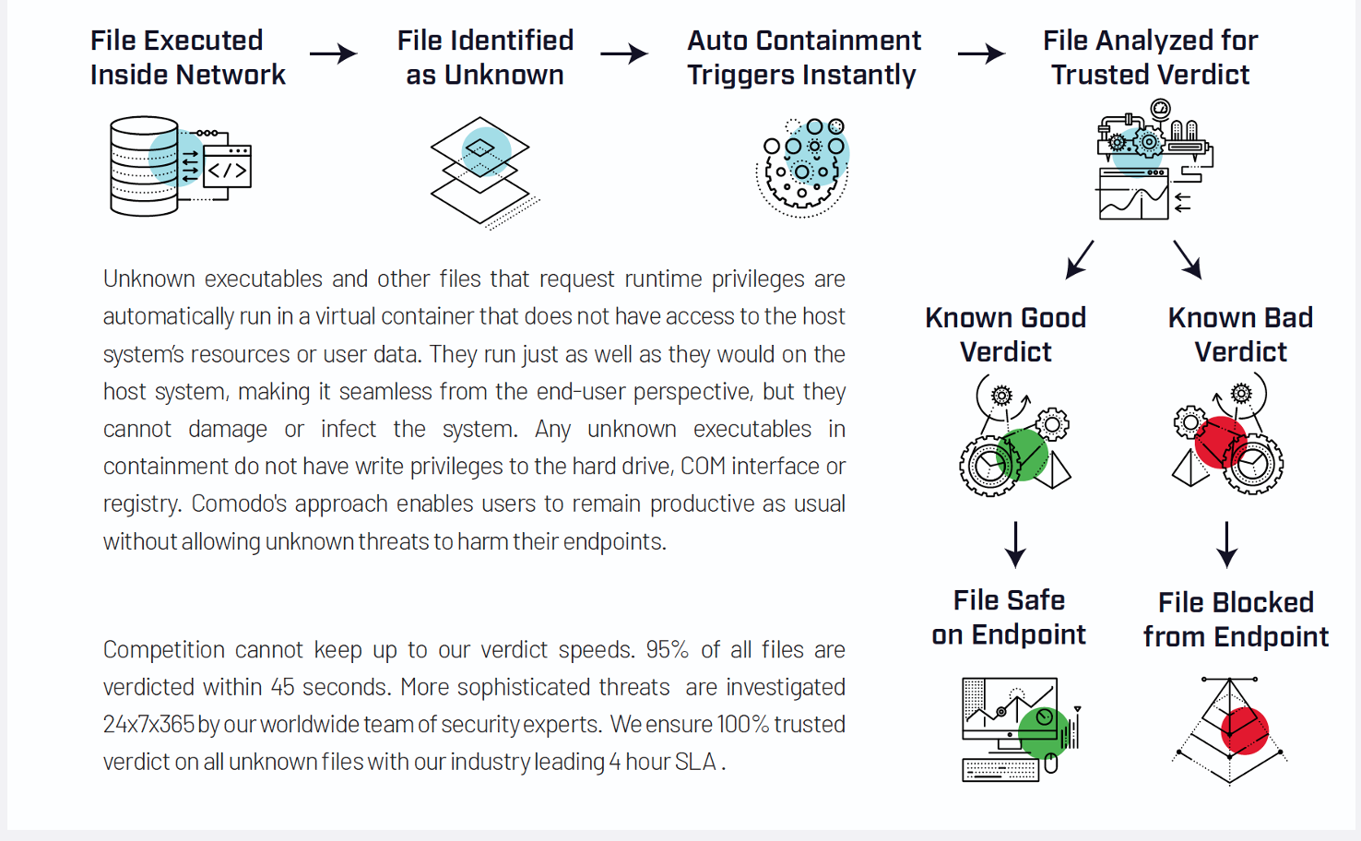
COMODO advanced endpoint protection

Slide 13
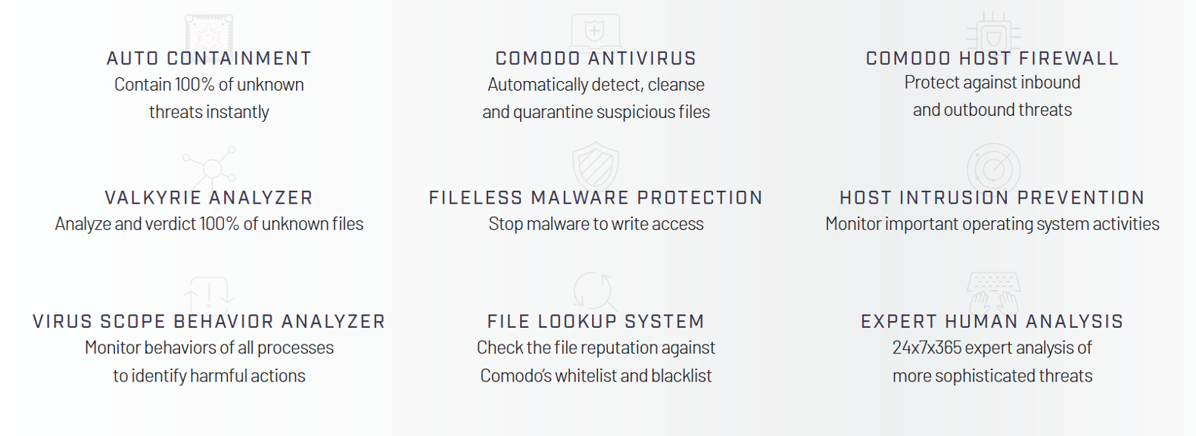
AEP FEATURES

Slide 14
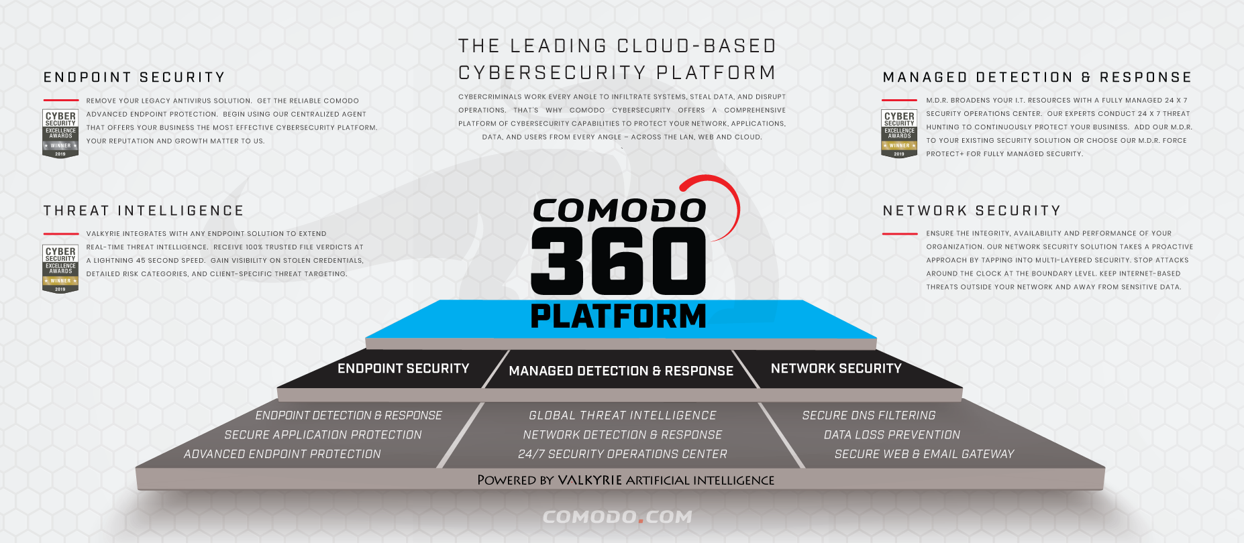
360 Solution
Get full coverage across your network, cloud and web with our cybersecurity solutions for your business safety and reputation
Notes:
1. Last thing I want to touch on before hanging things over to my engineer, is the different capabilities that we have to offer you guys. So we’ve taken a run through our Endpoint Security, and the threat intelligence via our cloud based verdicting system. And we’re going to get into it a little bit more once we hand things over to _(sales engineer name)_ for that demo in a minute.
2. But we also want to let you know that we are a full 360-degree solution vendor for basically any part of your organization. We have our network security which will offer the secured VNS Filtering, our DLP which is our data loss prevention secure web and email gateway as well.
3. As you can see in the middle we do have our Managed Detection & response. That’s more for the customers who r looking to off load there day to day security operations. We can actually handle that for you. What we’ll do is we’ll monitor your networks and your endpoints with our 24/7 SOC team. So you would allow us to be your security operations and run your day to day so that it’s taken off your plate for you.
4. Now the great part about this platform is it actually sits on ComodoOne which is our cloud-based management tool. What that offers you is remote management, mobile device management, patch management – (even at the 3rd party level for any updates you need to push out), as well as a service desk for ticketing so that anything your end-users need to bring to your attention they can do it through that. And like I said this can all be done through that ComodoOne Platform, and you get that at no cost to you.

Slide 15
Secure Internet Gateway (SIG)
Notes:
“Ask the question”

Slide 16
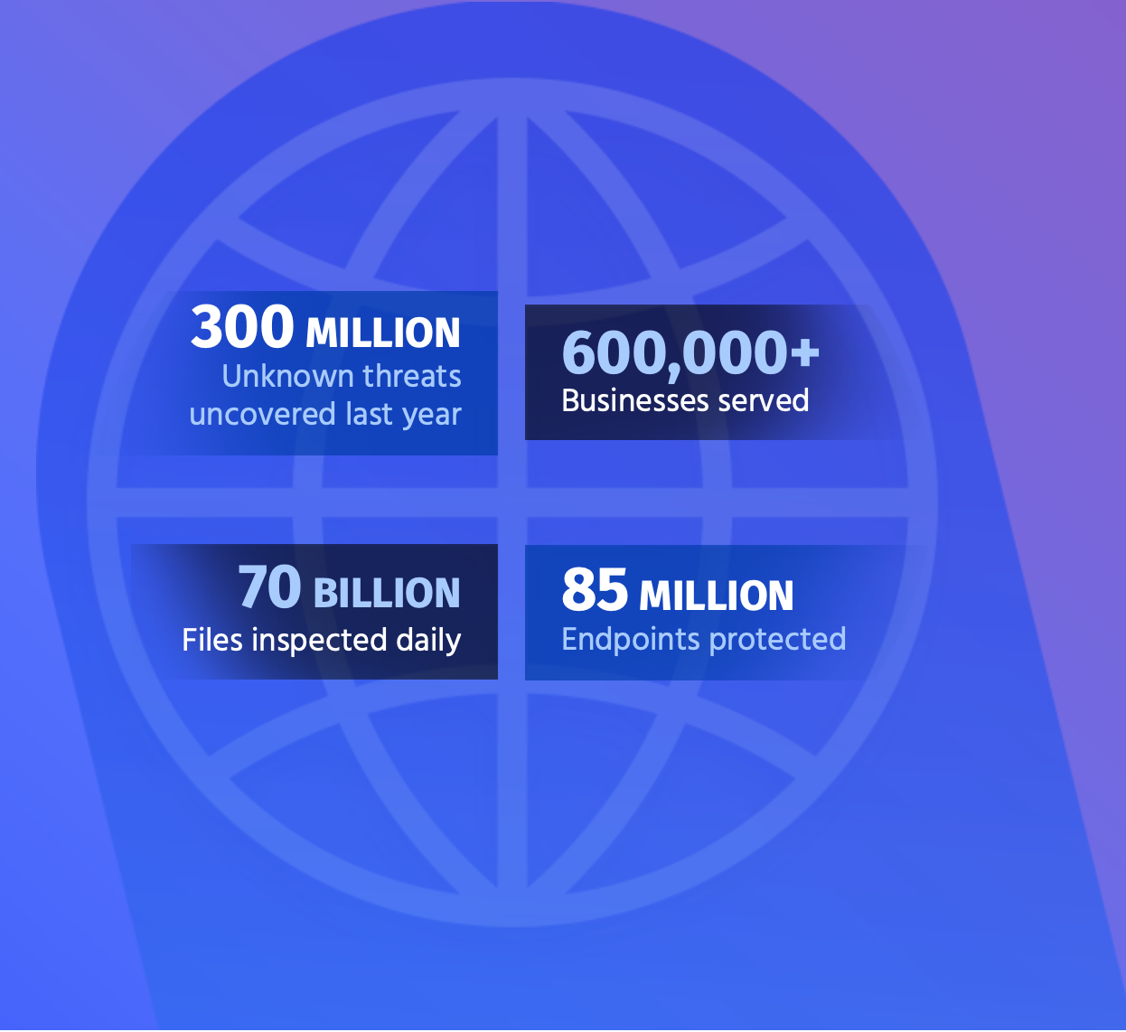
secure web gateway
64% of employees visit non-work related websites every day at the office
78% of people claim to know the risks associated with clicking unknown links and yet still click these links

Slide 17
Secure E-mail Gateway (SEG)
Notes:
“Ask the question”

Slide 18
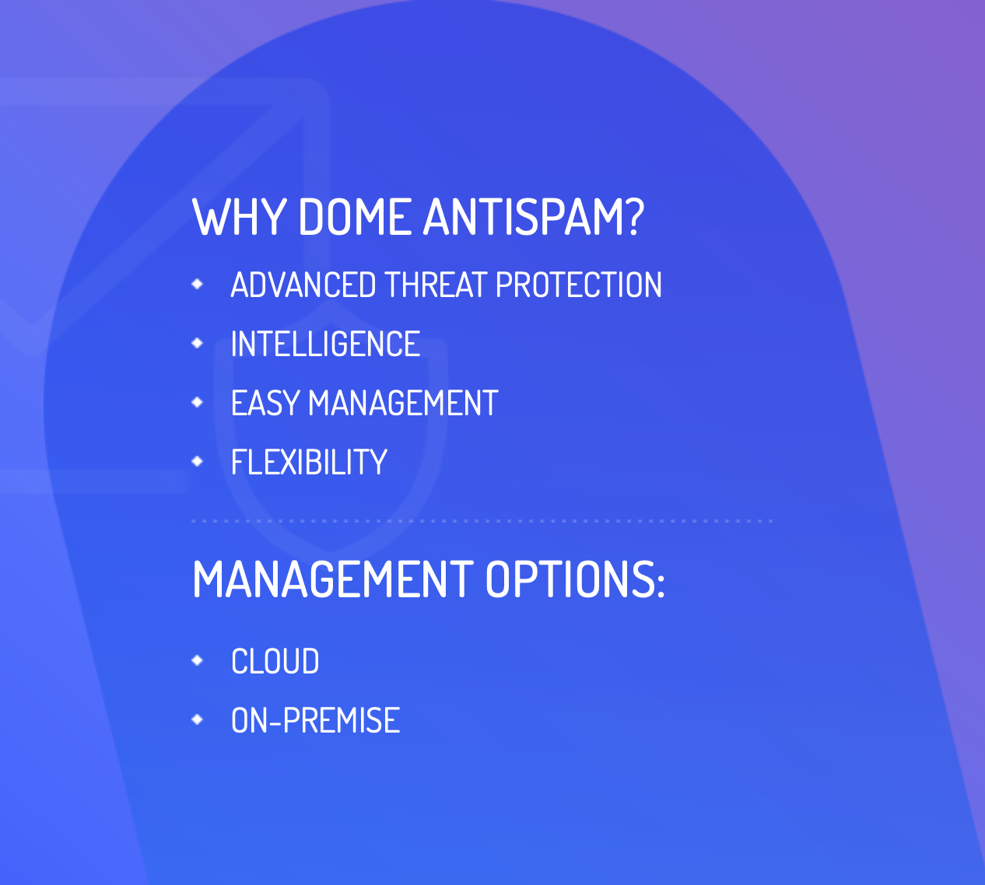
secure e-mail gateway
Over 70% of emails received by an organization are unsolicited
Almost 80% of malware infections originate from phishing emails and infected attachments

Slide 19
SOC as a Platform (SOCaaP)
Notes:
“Ask the question”

Slide 20
WHITE LABEL OUR SOC PLATFORM WITH YOUR BRAND
Patented auto containment technology is the world’s only active breach protection that neutralizes ransomware, malware, and cyber-attacks.
Eliminates all false positives and reduces attacker dwell time to mere minutes or even seconds.
Available with zero capital outlay.

Slide 21
Visual analytics
You and your customers will access co-managed SIEM as well as a visual analytics platform. It enables highlighting hidden threats, helps you understand the main causes of any incidents and describe it to your customers.

Slide 22
MULTI-TENANT SECURITY INCIDENT RESPONSE PORTAL
Gives a snapshot of your customer’s security statuses, incident escalations, reporting needs. It is also a central portal where all customer interactions can be managed.

Slide 23
Soc customer portal
Your customers will have a unique portal to monitor and interact with all SOC operations, incidents and tickets. This creates a unique communication channel where you can assure the customer about their security status as well as prove the value of the service.

Slide 24
Product Summary
Industry Recognition and Awards in Cybersecurity
AEP – Advanced Endpoint Protection
w/Full RMM Suite, Remote Control & Patching and Service Desk
SEG – Secure Email Gateway
SIG – Secure Internet Gateway
Retail/Home User – Comodo Internet Security Pro
MDR/SOCaaP – SOC as a Platform
Available in 1 user/3 user license keys
1 Hour POC’s for Each Product/Module
ANY Partner can request and get 20 User NFR licenses for ALL the Comodo Products….
MDR/SOC is last step after AEP is deployed
/ 48 Hour Setup Time…
Available in Spanish and Portuguese
Notes:
1. There are a few things I want to point out on this slide. First, just briefly about comodo, we’re been around for 2 decades now, we were actually leaders in the SSL certificate space back in 2004 but have since then sold off that side of the company to focus on our cybersecurity division.
2. As you can see at the top here, we’ve won a few big awards in the past, more notable the Cybersecurity Excellence Awards back in 2018. And even more recently, something we’re very proud of is we became a part of the Gartner Magic Quadrant. So out of 75 players in the industry they take the top 20 and we were lucky enough to make it on there, something that we’ve been very proud to be a part of. That’s only 20 companies per vertical annually.
3. We do a million scans daily protecting our customers. And with over 100 million agent instillations you can see we do have a pretty large global footprint.
4. As you can see at the top we do also have 1300 employees worldwide, why does that matter for you? It actually provides us with the ability to provide you with 365-day 24/7 support.

