Slide 1

ALGOSEC BUSINESS-DRIVEN SECURITY MANAGEMENT
Notes:
Hello all and thanks for coming,
Today I want to talk to you about one of the biggest challenges corporations have today when it comes to network security.
On one hand we have the business side of a company wanting to move very quickly to expose their application to the customer and we have security on the other hand who want to make sure everything is done in line with the best practices.
Today we will touch on how you can keep your security at the highest level well still keeping up with the speed of business.

Slide 2


















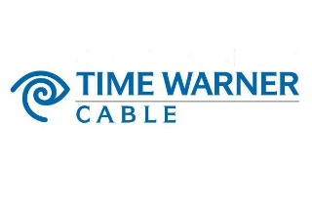








Corporate Overview
Founded 2004
1800+ Enterprise Customers
Serving 20 of the Fortune 50
24/7 Support via 3 Global Centers
Passionate about Customer Satisfaction
Notes:
Here’s a bit about our organization, we’ve been around since 2004, since then we’ve created a worldwide name for ourselves as leaders in both technology and in customer satisfaction, its not a coincidence that 20 of the fortune 50 companies are Algosec customers.

Slide 3




BUSINESS DRIVEN SECURITY MANAGEMENT
AlgoSec enables companies to align security with their business processes
  Business-driven Security
  Business-driven Agility
  Business-driven Visibility
Notes:
So what is this unique Algosec product you’ve been hearing about?
Network security is often seen as a burden, being extremely complex and taking up a lot of time, this can hurt a business trying to keep with the speed of the market but also wanting to keep the security at the highest level.
Algosec can assist you in enhancing your organizations security, by automatically assessing vulnerabilities, managing compliance and prioritizing rules.
By automatically enhancing your security, this will allow you organization the agility and speed it needs to not be held up by security.

Slide 4
Where Does Algosec Fit into your environment
Applications
INFRASTRUCTURE
AlgoSec
Enterprise Security Policy & Risk
Algosec lives at the intersection of your infrastructure, security policies and the applications that run your business.
We automate & manage the policy change process for accuracy & visualize your application estate and connectivity

Slide 5










BUSINESS-DRIVEN SECURITY MANAGEMENT
Business-Driven Network Security Policy Management
Business-Driven Security
Business-Driven Agility
Unified Visibility Across Cloud, SDN & On-Premise Enterprise Networks
Use cases
Change Management
Risk Management
Auditing &
Compliance
Incident Response
Micro-
Segmentation
DevOps
Business Continuity
Cloud
Security
Digital
Transformation
5

Slide 6
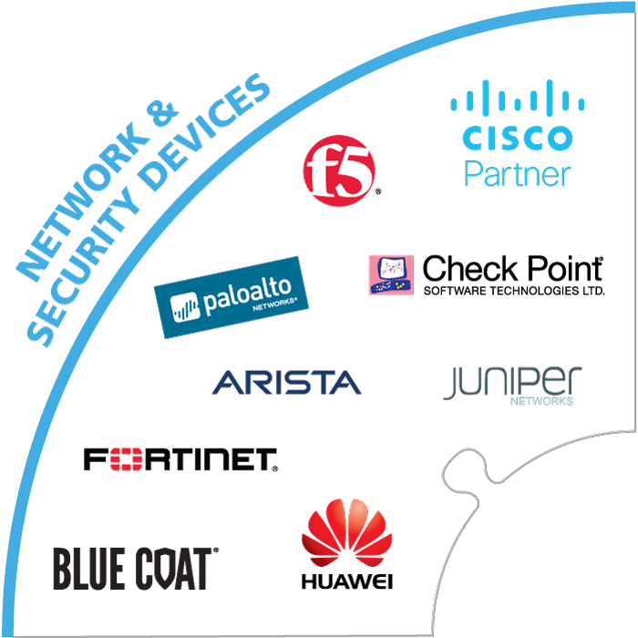
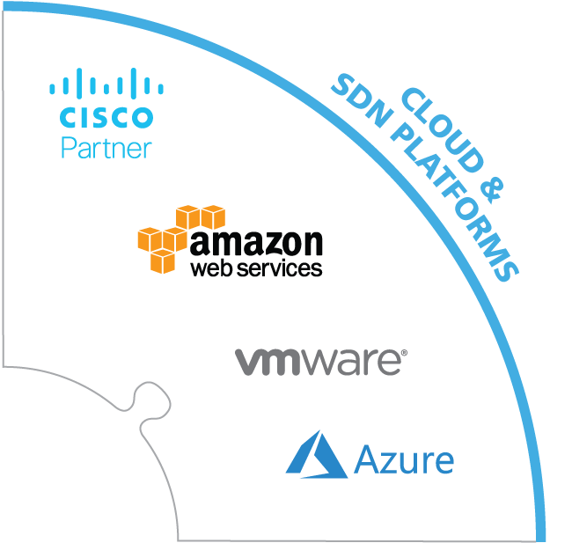
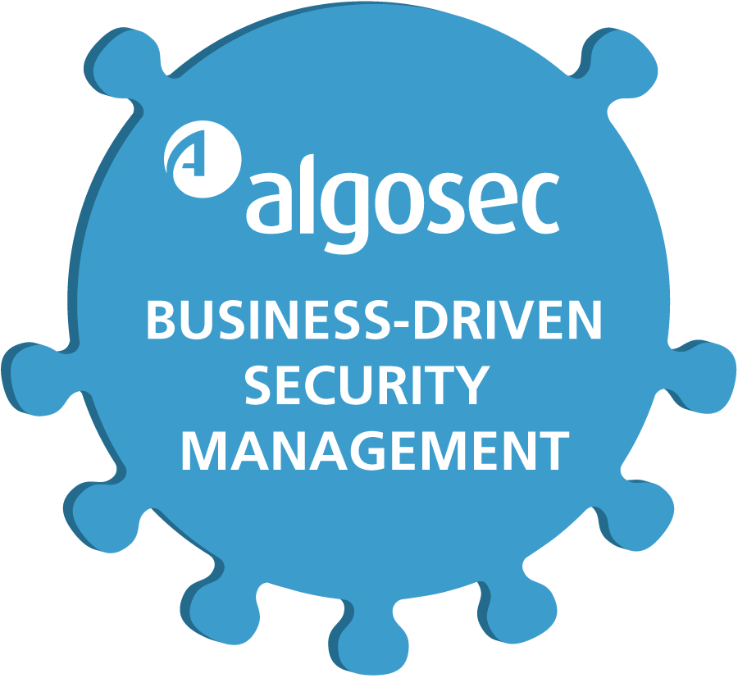
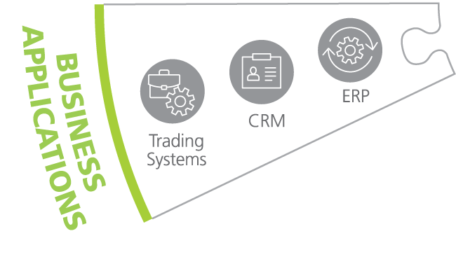
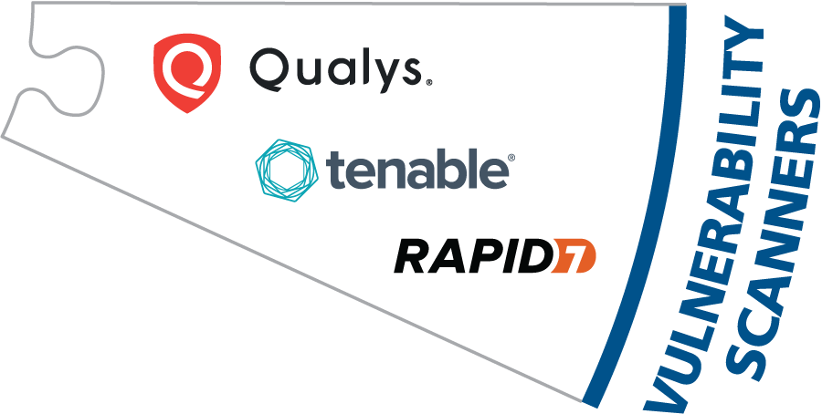
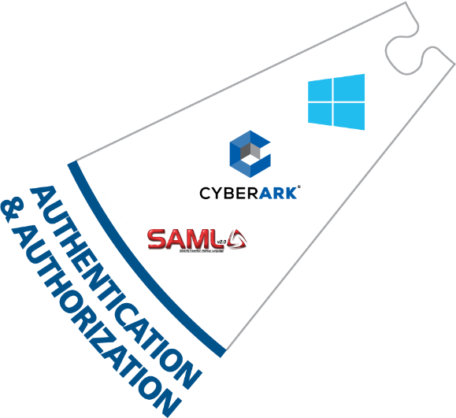
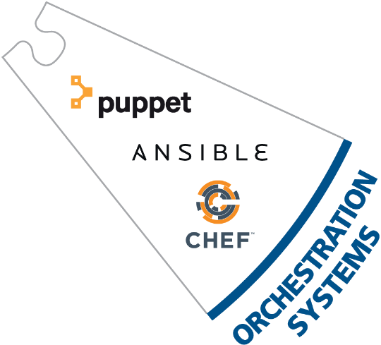
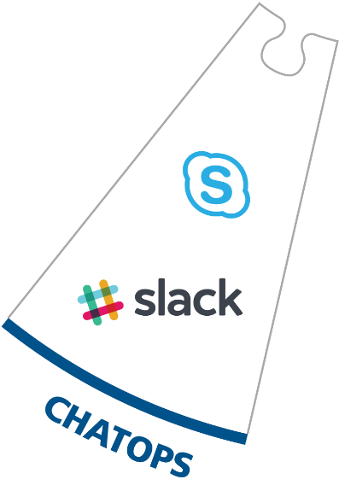
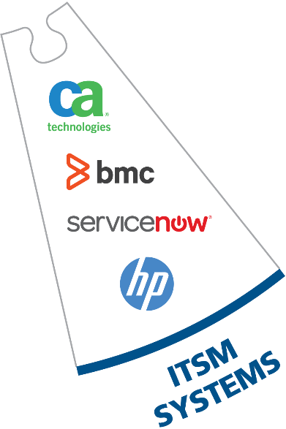
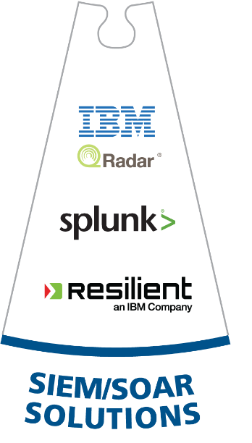
The AlgoSec ecosystem
ACI
Manage
Business Process
Integrate
For a complete list of supported devices visit www.algosec.com
Notes:
At Algosec we managing the leading physical, virtual and cloud firewalls in the market today, such as Checkpoint, Cisco, Fortinet, Juniper, AWS, Vmware, Microsoft Azure ext.
But this is not enough, At Algosec, we know our clients want their security management systems to seamlessly integrate with their whole ecosystem.
That’s why Algosec provides flexible integration with: SIEM solutions, Identity management systems, ITSM, Orchestration systems, Vulnerability Systems and much more.
Algosec also aligns with you business process, including different CRM and ERP applications.
In addition Algosec provides API’s that allows to easily integrate 3rd party systems.

Slide 7

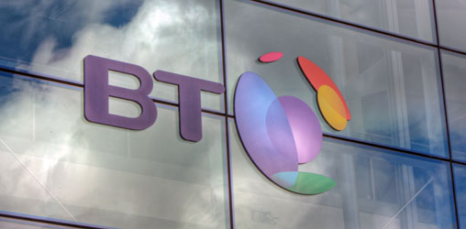
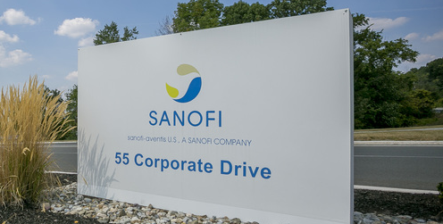
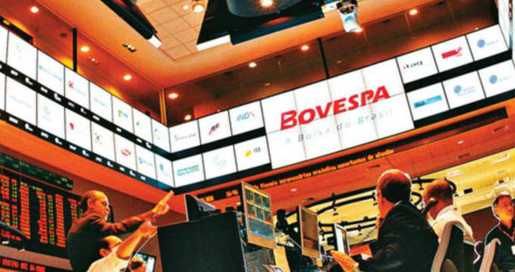
ROI in Under a Year
AlgoSec now does the heavy lifting for us, allowing our engineers to focus more time on security than on process and change.
Phil Packman
General Manager Security Gateway Operations
British Telecom
AlgoSec helped us reduce 80% of the time required to migrate the security of our applications as part of our data center consolidation project.
Bruno Rolleau
Network Security Architect
Sanofi
AlgoSec helps us maintain a problem-free environment. And because of operational efficiencies, the product paid for itself within the first year.
Wellington Vita,
Information Security Manager
BM&FBOVESPA
Notes:
At Algosec, customer satisfaction is our #1 priority.
But don’t take my word for it, see for example that Phil from British Telecom says that “AlgoSec now does the heavy lifting for us” and Bruno from Sanofi says that AlgoSec helped us reduce 80% of the time required to migrate the security of our applications.
We are extremely confident in the value our product brings to you corporation, that is why we offer a full money back guarantee.

Slide 8
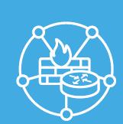


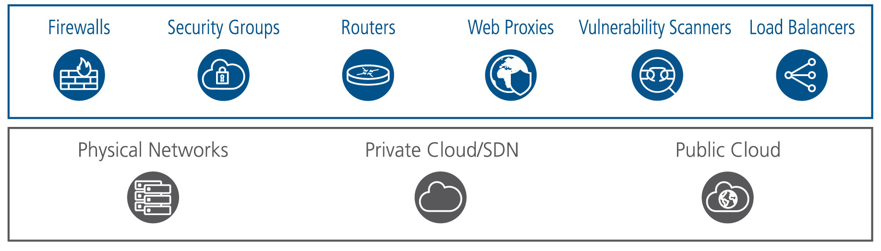
The AlgoSec Security Management Solution
AlgoSec Firewall Analyzer
Security Policy and Network Analysis
AlgoSec FireFlow
Security Policy Change Automation
AlgoSec Cloud
Cloud Security Management

Slide 9



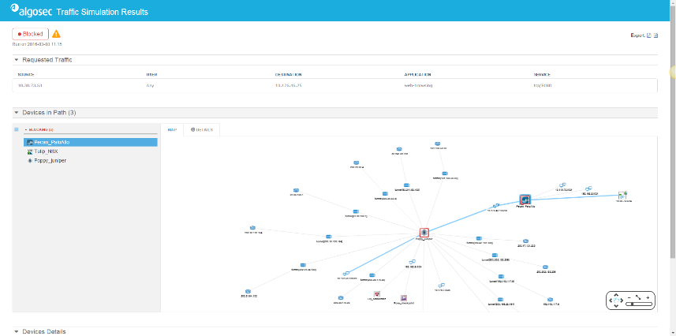



Network Abstraction & Policy Analysis
Visibility and analysis of complex network security policies across on premise and cloud networks.
Topology map and traffic simulation
Firewall rule optimization and cleanup
Audit-ready compliance reports
Risk assessment
Baseline configuration compliance
Network segmentation enforcement
Notes:
One of the main reasons you need to manage your security is because you want to optimize your network and FW policies and fix your vulnerabilities, but before you can do that, you would want to have a clear picture of your situation, you want to have a map of your network and a detailed list of your firewall policies. Next, you would want to analyze those polices to search for vulnerabilities. That is why AlgoSec Firewall Analyzer delivers visibility and analysis of complex network security policies across on-premise virtual and cloud networks, enabling optimization in configuring firewall routers web proxies and related network infrastructure, ensuring security and compliance.

Slide 10

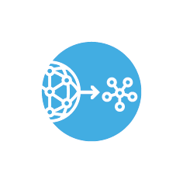

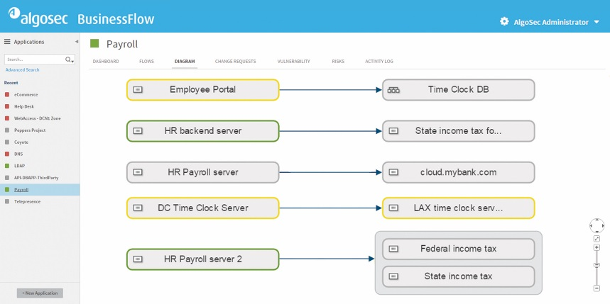



Application Connectivity Management
Discover, provision, maintain and securely decommission network connectivity for critical business applications.
Automated discovery and mapping of business connectivity
Translation of business requirements to networking terms
Impact assessment to avoid outages
Rapid datacenter and cloud migration
Business-centric risk analysis
Secure application decommissioning
Notes:
Dealing with the security of business applications can be difficult considering that on any given day, new business applications are added, changed or removed, which requires the implementation of complex, time-consuming network security changes. As you know, this can be extremely time consuming and is often neglected. Also, when decommissioning a server, you need to remove its network security flows to prevent security “holes” in your security posture.
What can make your life a lot easier? If you had a clear map that mapped your business applications and how they connected to the Security Network,
You could then easily decommission applications, accelerate business application migrations to the cloud, avoid outages and ensure application security and compliance across virtual, cloud and physical networks.

Slide 11



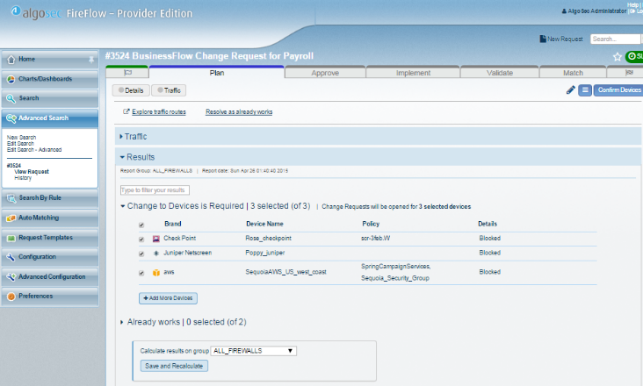



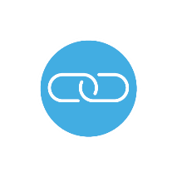
Security Policy Change Automation
Process firewall changes with zero-touch automation.
Security policy workflow automation
Topology analysis and optimal rule design
Proactive risk and compliance verification
Automated policy push
Change validation and reconciliation
SLA tracking and complete audit trail
Integration with ticketing systems
Notes:
Network Security Policy changes are needed very often, which makes manually implementing changes almost impossible, and will often hold up the business, the only way to properly stay “on top” of the needed policy changes is with highly automated system that can assist you with finding the rules that require the change and automatically pushing the changes to the FW. Luckily, Algosec got you covered, with Algosec FireFlow you can process firewall changes with zero-touch, assess the impact of network changes to ensure security and continuous compliance, automate rule recertification processes, and automatically document the entire change management lifecycle. Think of the time and aggravation this will save you.

Slide 12

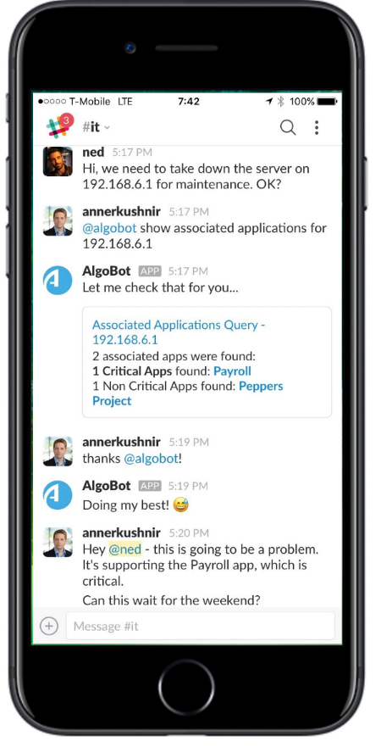




CHATOPS WITH ALGOBOT
Offloads daily tasks from firewall/network admins
Gives end-users self-service access to firewall connectivity data, saving time and improving service.
Provides easy, convenient access to AlgoSec
  Allows firewall/network admins to quickly perform security policy management tasks from the convenience of a chat room or mobile device.
Ideal for checking on:
Application Connectivity
Network connectivity
Firewall change requests
Impact of maintenance tasks on applications
Security incidents
And it’s multilingual too!
Notes:
Keeping up with our solutions agile, quick and fully automated reputation. Algosec recently launched a new state-of-the-art bot to create a one-stop-shop for you security management needs, instead of having to go through long processes for every small check or review, just tell the bot what you want, and you will instantly get a reply.
The AlgoBot is perfect for quickly checking things like Application and Network Connectivity, Firewall change requests, easily review the Impact of maintenance tasks on applications, check Security incidents and so much more.

Slide 13






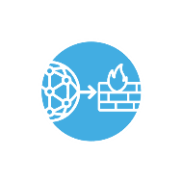








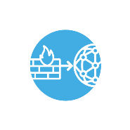





THE SECURITY POLICY MANAGEMENT LIFECYCLE
Auto-discover and map application connectivity and security infrastructure
Enable developers to define connectivity programmatically
Decommission redundant firewall rules and application connectivity
Discover or Define
Translate application connectivity into firewall rules
Assess risk and compliance
Tie cyber attacks and vulnerabilities to business processes
Decommission
Plan & Assess
Policy monitoring
Enforce security posture
Out-of-the box auditing and compliance reports
Link firewall rules to applications
Policy clean up and optimization
Firewall rule recertification
Automatically migrate firewall rules
Zero-touch change management
Automated policy push
Smart validation
Maintain
Migrate & Deploy

Slide 14



Laser-Focused on Delivery
Our team is measured on YOUR post-production satisfaction
DEPLOYMENT
METHODOLOGY
PROFESSIONAL SERVICES
TRAINING
Phased approach to deployment in production delivers the quickest and most cost-effective path to ROI
Our experts can tailor our solution to your environment and business objectives, and empower you to continue on your own
Wide range of training classes – on-demand, virtual and on-premise to help you gain the expertise you need to get value quickly
Notes:
Algosec don’t “disappear” after your purchased the product, but we are with you the whole way to until its running smoothly at you corporation,
Implementing new solutions into your company can sometime create outages and down time, Algosec specializes in a quick efficient deployment methodology, our solution is implemented in an easy and quick way, having you back to work in no time.
In addition, at Algosec we know that every corporation is unique, our professional services are available to tailor the solution to perfectly fit you organization
one of Algosec’s biggest advantage is the high level of support and customer care we provide after implementation, Algosec provides excessive training and professional tech support located worldwide and available 24x7x365

Slide 15

Why AlgoSec?
Business-Driven Security Policy Management
Focus on business applications
Business-centric risk analysis
ROI in Under a Year
Superior Technology
Industry-leading topology analysis
Rich automated workflows
Depth and breadth of supported devices
Truly integrated solution
“Obsessed” with
Customer Satisfaction
Money back guarantee since 2005
Post-sale success focus
Trusted by 20 of the Fortune 50
Notes:
Business-Driven Security Policy Management – in addition to the security network, Algosec focuses on business applications, running a business-centric risk analysis.
Superior Technology – Algosec’s is considered the technology leader in its field, with the Industry-leading topology analysis and the most advanced automated workflows, with state of the art zero-touch technology
“Obsessed” with Customer Satisfaction – Algosec is unique in the way that we our relationship with our client doesn't end at the purchase, but it only begins then, Algosec is “obsessed” with costumer satisfaction throughout the whole process, and that’s why we are confident enough to offer a full money back guarantee.

Slide 16
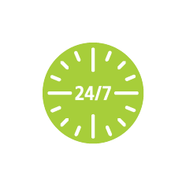




Why now?
Strengthen your cybersecurity posture by reducing your attack surface
Bring modern agility to security policy management
Avoid costly outages from wrongly configured network devices
Ensure continuous compliance and reduce your risk of audit failure
Tie cyber threats to business processes to gain boardroom mindshare
Address the security talent shortage with intelligent automation
Notes:
Why would your company benefit from a solution like this now?
Because you want to strengthen your cybersecurity
Because you don’t want to waste time managing changes and updates to your FW policy
Because you want to avoid out outages due to wrongly configured network devices
Because you want compliance and audits to take minutes, not months
Because you want to better understand your security from a business perspective.
Because you want you network to automatically be kept secure and optimized.

Slide 17

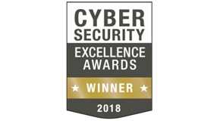
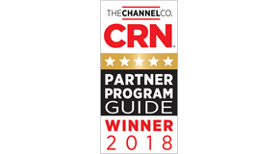




Notes:
There's no debate that Algosec is the leader in the Network Security Policy Management field, we have won many awards, you can see a few of them here, but our real proof of quality is our customer satisfaction. Our good name proceed us, give of the chance to provide you with the award winning, market leading product.

Slide 18
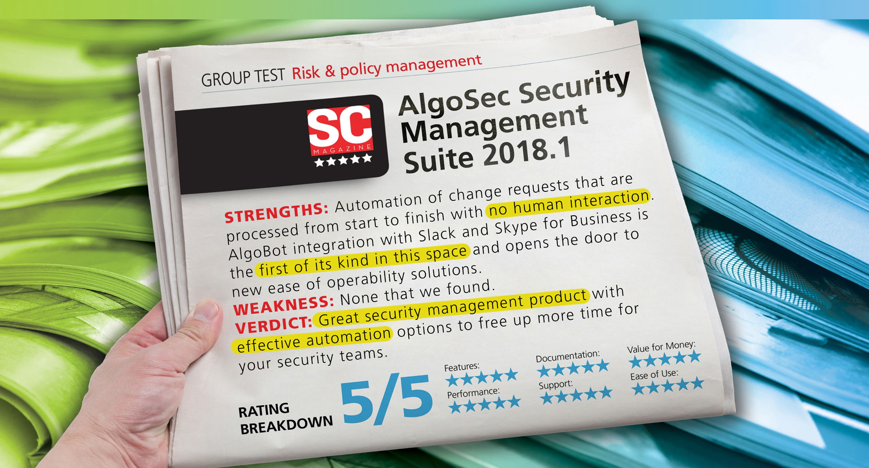
Notes:
Our product has won many awards, here is an example of one review we’ve gotten in SC magazine:
STRENGTHS: Very strong security management tool with strong
WEAKNESSES: None that we found.
VERDICT: This is an excellent tool, especially for mid - to large sized
organizations. It has everything you need and is comfortably
manageable.

Slide 19
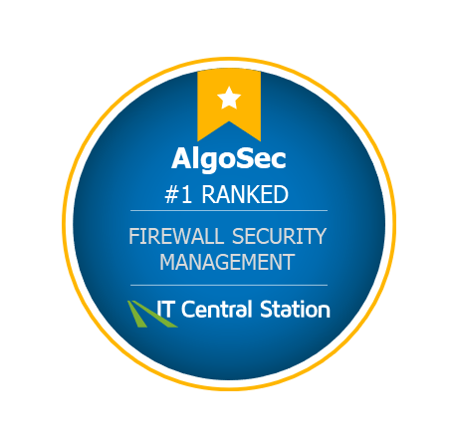
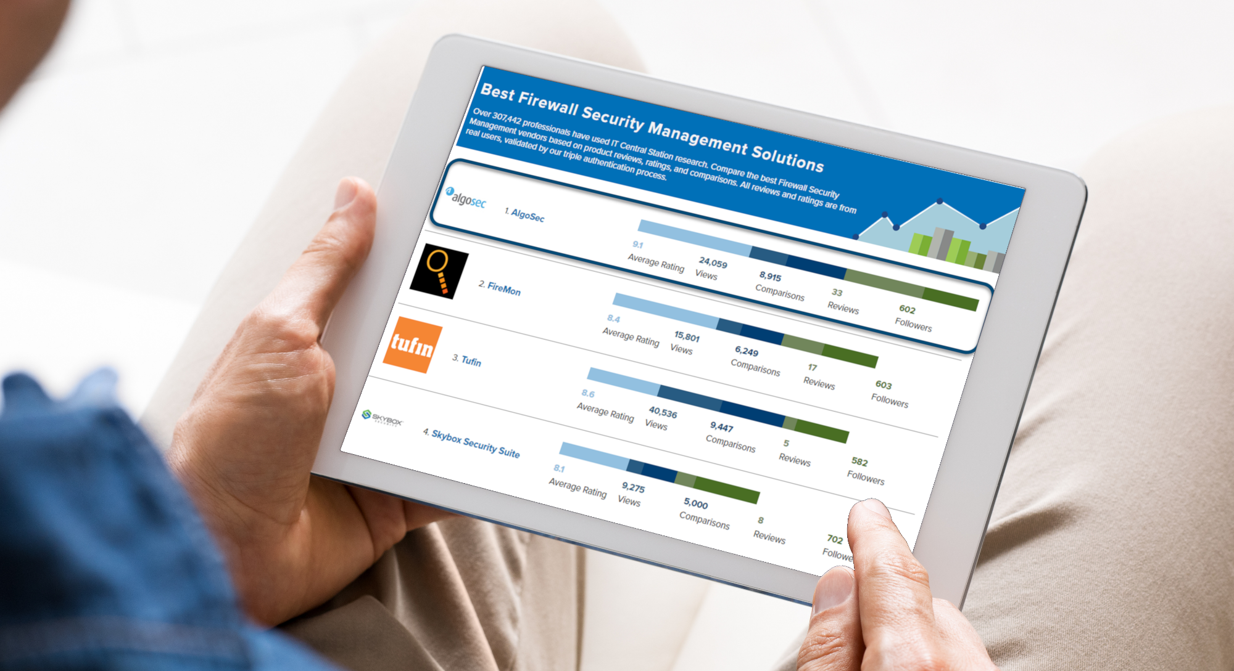
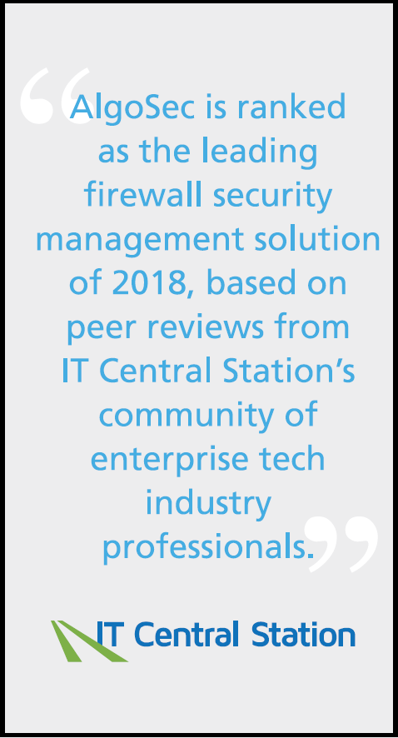
Notes:
Ranked #1 in IT Central Station – real customers reviews

